Slide 1
Network Modeling for Psychological (and Attitudinal) Data
11/01/2017 – 12/01/2017 Oldenburg
Adela Isvoranu & Pia Tio
http://www.adelaisvoranu.com/Oldenburg2018

Slide 2
Workshop Overview
Thursday January 11
Morning
Introduction & Theoretical Foundation of Network Analysis
Drawing Networks in R (part of practical)
Afternoon
Network Estimation(Markov Random Fields: Gaussian Graphical Model & Ising Model)
Estimating Networks in R
Friday January 12
Morning
Network Stability
Afternoon
Advanced Methods (Network Comparison Test, Mixed Graphical Models, Latent Variable Network Modeling)

Slide 3
Afternoon Session Overview
Network Estimation
Part 1. Conditional independence
Part 2. Pairwise Markov Random Fields
Part 3. Pairwise Markov Random Fields 1: Ising Model
Part 4. Pairwise Markov Random Fields 2: Gaussian Graphical Model
Part 5. Regularisation
Estimating networks in R & Practical Session

Slide 4
When to estimate
Nodes are known: your variables (but don’t just include everything – we will come back to this)
Edges are unknown: this is the part we need to estimate from data

Slide 5
Afternoon Session Overview
Network Estimation
Part 1. Conditional independence
Part 2. Pairwise Markov Random Fields
Part 3. Pairwise Markov Random Fields 1: Ising Model
Part 4. Pairwise Markov Random Fields 2: Gaussian Graphical Model
Part 5. Regularisation
Estimating networks in R & Practical Session

Slide 6
Different types of relationships
When we relate 5 variables to say depression severity, we can do this in various ways:
How each variable is related to depression severity (correlation)
How each variable predicts depression severity (regression)
How each variable uniquely predicts depression severity (multiple regression)
Note: ‘uniquely’ here means controlling for all other variables in the network. You can’t control for something that’s not in the network.

Slide 7
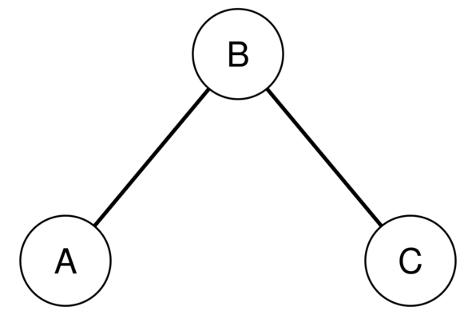
Conditional Independence
B separates A and C
A and C are independent conditional on B

Slide 8
Conditional independence
Amount Ice cream sold
# Children drown
Temp/
Sunny weather

Slide 9
Different types of relationships
When we relate 5 variables to say depression severity, we can do this in various ways:
How each variable is related to depression severity (correlation)
How each variable predicts depression severity (regression)
How each variable uniquely predicts depression severity (multiple regression)
In network psychometrics we are usually interested in the last, also called conditional independence relationships: we want to know how symptoms A and B are related after controlling for all other symptoms

Slide 10
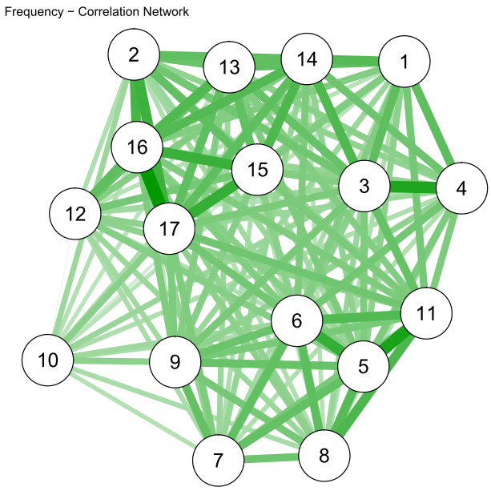
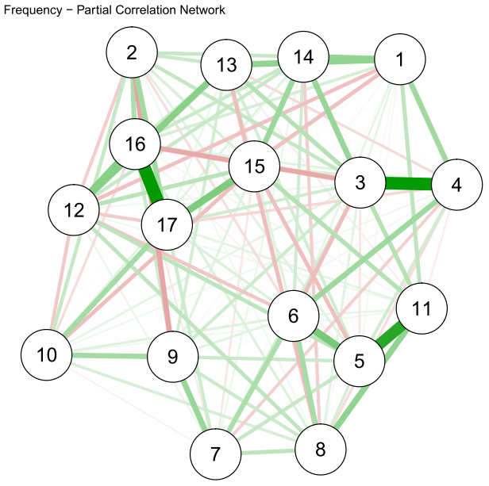
Does type of relationship matter?
Correlation network
Multiple regression network

Slide 11
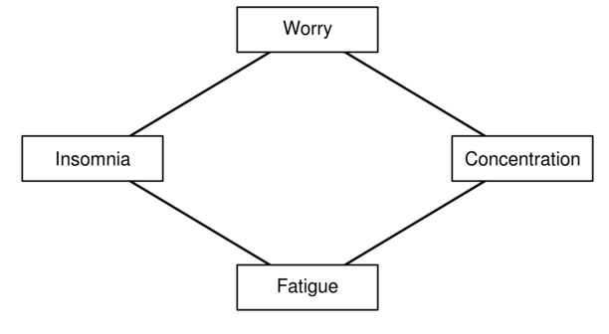
Conditional independence

Slide 12
Afternoon Session Overview
Network Estimation
Part 1. Conditional independence
Part 2. Pairwise Markov Random Fields
Part 3. Pairwise Markov Random Fields 1: Ising Model
Part 4. Pairwise Markov Random Fields 2: Gaussian Graphical Model
Part 5. Regularisation
Estimating networks in R & Practical Session

Slide 13
Pairwise Markov Random Fields
A pairwise Markov Random Field (PMRF) is an undirected network
A PMRF is a network model in which edges indicate the full conditional association between two nodes after conditioning on all other nodes in the network
Two nodes are connected if they are not independent conditional on all other nodes
Two nodes are not connected if they are independent conditioned on all nodes
We can think of PMRFs as partial correlation networks

Slide 14
Conditional independence relationships
The edges in a PMRF can be interpreted in several ways. The most relevant for us are:
A representation of conditional independence relationships
Pairwise interactions

Slide 15
Conditional independence relationships
B separates A and C
A and C are independent conditional on B

Slide 16
PMRFs can be found everywhere!
PMRFs have been used in many disciplines
Physics
Machine Learning
Artificial Intelligence
Biometrics
Economics
Image processing http://cs.stanford.edu/people/karpathy/visml/ising_example.html
Neural Networks http://nxxcxx.github.io/Neural-Network/

Slide 17
Pairwise Markov Random Fields
Ising Model
All nodes are binary
Combination of multiple logistic regression models
Gaussian Graphical Model (GGM)
All nodes assumed normally distributed
Combination of multiple linear regression models
Advanced: Mixed Graphical Model (MGM)
Different types of variables

Slide 18
Afternoon Session Overview
Network Estimation
Part 1. Conditional independence
Part 2. Pairwise Markov Random Fields
Part 3. Pairwise Markov Random Fields 1: Ising Model
Part 4. Pairwise Markov Random Fields 2: Gaussian Graphical Model
Part 5. Regularisation
Estimating networks in R & Practical Session

Slide 19
Ising Model = multiple logistic regressions
For the Ising Model we can estimate a PMRF by predicting each node from all other nodes in multiple (logistic) regressions
This gives us two parameters for each edge in the network
Regression parameter from predicting A from B and B from A
We can estimate the edge weight as mean of these two parameters
We do the same for MGM

Slide 20
Multiple logistic regression
A ~ B + C
B ~ A + C
C ~ A + B
AB = BA = (B + A ) / 2
The association between A and B (AB) is the mean of the two regression coefficients A on B and B on A.

Slide 21
Multiple logistic regression
A ~ B + C
B ~ A + C
C ~ A + B
AB = BA = (B + A ) / 2
AND vs. OR rule: AND only retains edge when both coefficients are non-zero; OR retains edge when either is non-zero

Slide 22
Ising Model
For binary data
The conditional distribution for node i given that we observe all other nodes is:
This is a multiple logistic regression model
The Ising model is a combination of predictive models. Edges represent how strongly one node predicts another
AND vs OR rule

Slide 23
Afternoon Session Overview
Network Estimation
Part 1. Conditional independence
Part 2. Pairwise Markov Random Fields
Part 3. Pairwise Markov Random Fields 1: Ising Model
Part 4. Pairwise Markov Random Fields 2: Gaussian Graphical Model
Part 5. Regularisation
Estimating networks in R & Practical Session

Slide 24
Gaussian Graphical Model
GGM, for continuous, normal distributed data
Other names: Gaussian Random Field, Concentration Graph, Partial Correlation Network
While we can estimate the GGM similar to the Ising Model (via many regressions), a more efficient way is to obtain the negative inverse covariance matrix of the multivariate normal distribution, also called precision matrix
Standardized elements of this negative inverse precision matrix are equal partial correlation coefficients which are our edge weights in the network
We therefore don't need the AND or OR rule here.

Slide 25
GGM = multiple linear regressions
If we observe the value of every node except node i we obtain the following (assuming all variables are standardized):
In which θ is the i-th diagonal element of the precision matrix, also called the residual variance
This is a multiple linear regression model!
Similar to the Ising model, the GGM shows how well nodes predict each other

Slide 26
GGM – Latent variable model
A
B
C

Slide 27
What is my data is…
… ordinal?
Use option cor_auto in qgraph which calculates polychoric correlations
… continuous non-normal?
Use function huge.npn from the R package which implements the NonparaNormal tranformation
… mixed?
Use Mixed Graphical Model (MGM), more on that tomorrow.

Slide 28
Afternoon Session Overview
Network Estimation
Part 1. Conditional independence
Part 2. Pairwise Markov Random Fields
Part 3. Pairwise Markov Random Fields 1: Ising Model
Part 4. Pairwise Markov Random Fields 2: Gaussian Graphical Model
Part 5. Regularisation
Estimating networks in R & Practical Session

Slide 29
What is the problem?
PMRFs require a lot of data because many parameters are estimated
A network with 20 nodes already has 190 edge parameters, a 50-node network has 1225 edge parameters
For i nodes: (i * i - 1) / 2 edge weights + i thresholds
Our goal is to obtain
Easily interpretable / parsimonious network
Stable network that more likely reflects our true data generating model

Slide 30
Thresholding
Solution: remove all edges below a certain threshold
Watch out, this influences centrality measures
Different options
Just a number
threshold = 0.3
Correct for false positives
threshold = “bonferroni” or “fdr” or “localfdr” or…

Slide 31
Regularisation
Solution: estimate networks with the least absolute shrinkage and selection operator (lasso)
The lasso shrinks all regression coefficients, and small ones are set to zero (drop out of the model)
Interpretability: only strong edges retained in the network
Stability/replicability: avoids obtaining spurious edges only due to chance
We also have less parameters to estimate
Regularisation returns a sparse network: few edges are used to explain the covariation structure in the data (parsimony)
Notes:
Strong is not necessarily the same as relevant!
Absence of edge does not mean that there’s no relationship!

Slide 32
Be aware
Strong edges ≠ relevant edges
Absence of edge ≠ the absence of a non-zero relationship between two variables
All edges are shrunken. This means that the absolute edge weights do not reflect the “true” edge weights
Regularisation depends on sample size

Slide 33
Regularising the Ising Model
We use the eLasso (EBIC Lasso) that selects the optimal value of the tuning parameter λ (lamdba) based on minimizing the Extended Bayesion Information Criterion (EBIC)
Many models are estimated, the one with the best fit (lowest EBIC) is picked
The EBIC hyperparameter γ (gamma) decides how many edges we recover. Setting γ to 0 leads to a network based on the BIC (non-conservative, erring on the side of discovery); γ defaults for erring on the side of caution are 0.25 (Ising Model) and 0.5 (GGM)
eLasso is applied node-wise in each logistic regression

Slide 34
Regularisation for the GGM
The graphical lasso (gLasso) is a variant of the lasso that is optimalized for computing inverse covariance matrices. The glasso also requires a tuning parameter λ which we select by minimizing the EBIC
We also have to choose the hyperparameter γ to choose between discovery and being conservative (GGM default = 0.5)
We could do node-wise regularisation (applying the lasso to each regression similar to the Ising Model), but the glasso is faster for the GGM, so we apply it when estimating the inverse covariance matrix that equals the partial correlation matrix instead

Slide 35
Regularisation summary
We automatically estimate many network models in qgraph, and pick the best-fitting one using the tuning parameter λ
For the hyperparameter γ,we have to decide whether we want to err on the side of discovery (low values) or on the side of sparsity (high values).

Slide 36
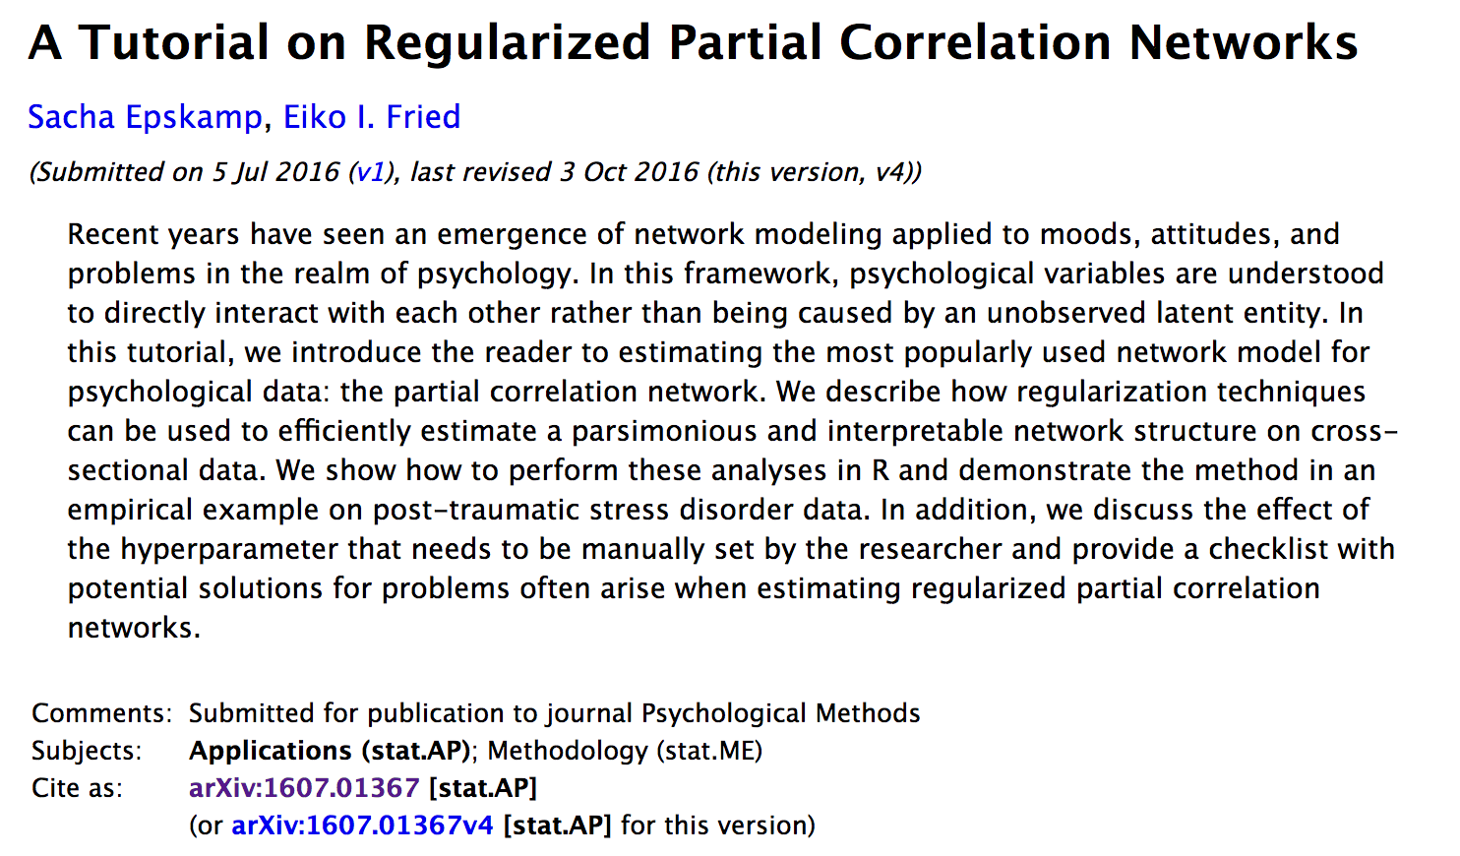
https://arxiv.org/abs/1607.01367

Slide 37
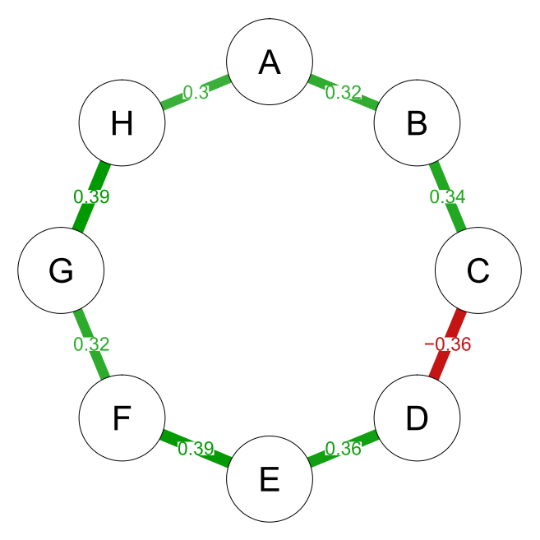
Regularisation tutorial paper
True network

Slide 38
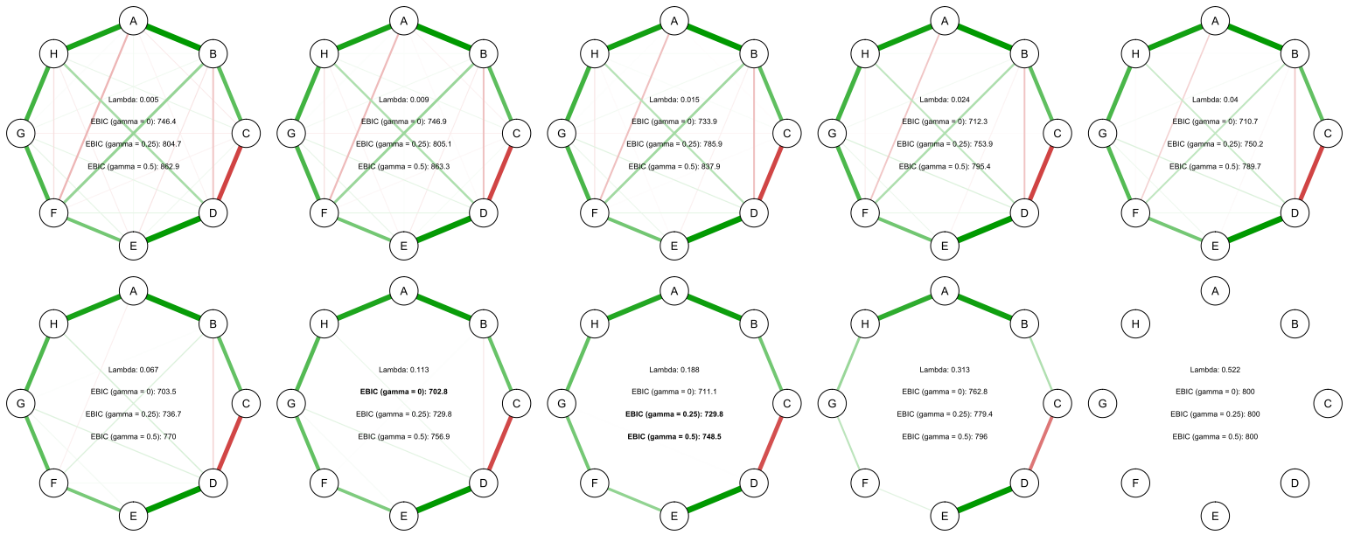
Regularisation tutorial paper
Automatically calculate 100 networks (by varying λ)
Notes:
We use the eLasso (EBIC Lasso) that selects the optimal value of the tuning parameter λ (lamdba) based on minimizing the Extended Bayesion Information Criterion (EBIC)
Many models are estimated, the one with the best fit (lowest EBIC) is picked
The EBIC hyperparameter γ (gamma) decides how many edges we recover. Setting γ to 0 leads to a network based on the BIC (non-conservative, erring on the side of discovery); γ defaults for erring on the side of caution are 0.25 (Ising Model) and 0.5 (GGM)

Slide 39
Regularisation tutorial paper
Pick best model via EBIC, depending on setting for γ
Notes:
We use the eLasso (EBIC Lasso) that selects the optimal value of the tuning parameter λ (lamdba) based on minimizing the Extended Bayesion Information Criterion (EBIC)
Many models are estimated, the one with the best fit (lowest EBIC) is picked
The EBIC hyperparameter γ (gamma) decides how many edges we recover. Setting γ to 0 leads to a network based on the BIC (non-conservative, erring on the side of discovery); γ defaults for erring on the side of caution are 0.25 (Ising Model) and 0.5 (GGM)

Slide 40
Summary
In network theory we are often interested in the conditional independence relationships: how are two variables uniquely related/controlling for all other variables.
Ising model (binary) and Graphical Gaussian model (normally distributed continuous) use multiple regression to estimate the relationship strength between variables.
Regularisation is needed to keep the networks stable and (relatively) easy to interpret.

Slide 41
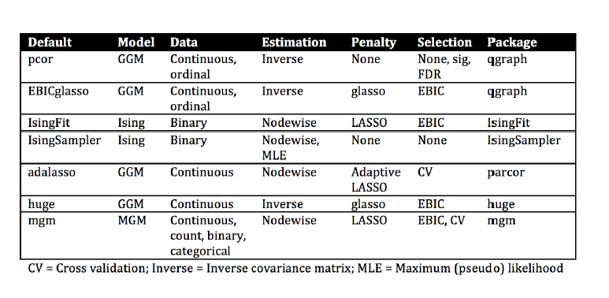
Overview

Slide 42
Break

Slide 43
Afternoon Session Overview
Network Estimation
Part 1. Conditional independence
Part 2. Pairwise Markov Random Fields
Part 3. Pairwise Markov Random Fields 1: Ising Model
Part 4. Pairwise Markov Random Fields 2: Gaussian Graphical Model
Part 5. Regularisation
Estimating networks in R & Practical Session

Slide 44
Workshop Overview
Thursday January 11
Morning
Introduction & Theoretical Foundation of Network Analysis
Drawing networks in R (part of practical)
Afternoon
Network Estimation and Inference (Markov Random Fields: Gaussian Graphical Model & Ising Model)
Estimating networks in R
Friday January 12
Morning
Network Stability
Afternoon
Advanced Methods (Network Comparison Test, Mixed Graphical Models, Latent Variable Network Modeling)

Slide 45
Important R-packages
qgraph: estimation and visualisation of correlation networks, partial correlation networks, and GGMs
IsingFit: estimation of Ising Models
bootnet: testing the stability of networks
dplyr & tidyr: make life easier
These packages call dozens of other important packages, for instance for the regularisation. Make sure to keep R, R-Studio, and all R-packages up to date.

Slide 46
Visualisation in qgraph
In qgraph, the Fruchterman-Reingold algorithm is used that iteratively computes optimal placement of nodes
Most central nodes will end up more in the center, least central nodes more in the periphery
Per default, saturated/thicker edges represent more closely associated nodes; green = positive, red = negative nodes

Slide 47
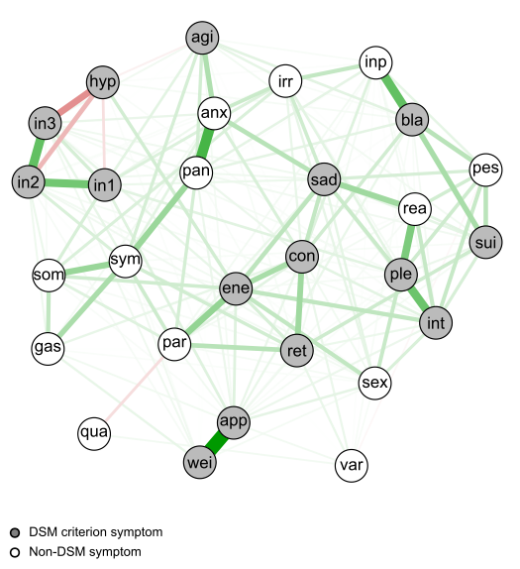
Visualisation in qgraph

Slide 48
Note about visual interpretation
While central nodes will end up in the center, and least central nodes in the periphery, the FR algorithm is a 2-dimensional rendition of a high-dimensional space
We cannot conclude that the visually most central node is also the statistically most central node (for that we need to look at the centrality measures).

Slide 49
Estimating networks in R
Example dataset: 359 women with post-traumatic stress disorder (PTSD) enrolled in community-based substance abuse treatment programs across the United States
We use frequency ratings of 17 PTSD symptoms from the PTSD Symptom Scale-Self (0=not at all; 3=at least 4-5 times a week)
Data can be downloaded from the National Institute on Drug Abuse
https://datashare.nida.nih.gov/study/nida-ctn-0015
Detailed instruction on how to load data into R in supplementary material of arXiv preprint (bottom link)
arXiv preprint: https://arxiv.org/abs/1604.08462

Slide 50
Data preparation
Load qgraph
Because we have ordinal data, we estimate polychoric correlations among variables
cor_auto returns the appropriate correlations among variables
library("qgraph")
FreqCors <- cor_auto(FreqBaseline)

Slide 51
Data preparation
Let's look at the covariance matrix of the 17 symptoms
FreqCors2 <- FreqCors
colnames(FreqCors2)<- c(1:17)
rownames(FreqCors2)<- c(1:17)
FreqCors2

Slide 52
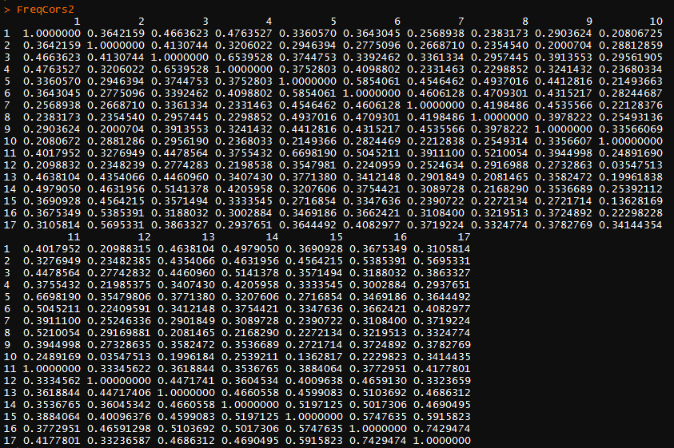
Data preparation

Slide 53
Correlation network
In our first network—the correlation network—edges are simply the polychoric correlations among symptoms
Plot network:
g1 <- qgraph(FreqCors, layout = "spring", labels = TRUE, nodeNames = labs, title = "Frequency - Correlation Network", legend.cex = 0.5)
pdf("g1.pdf", width=10, height=7)
qgraph(g1)
dev.off()

Slide 54
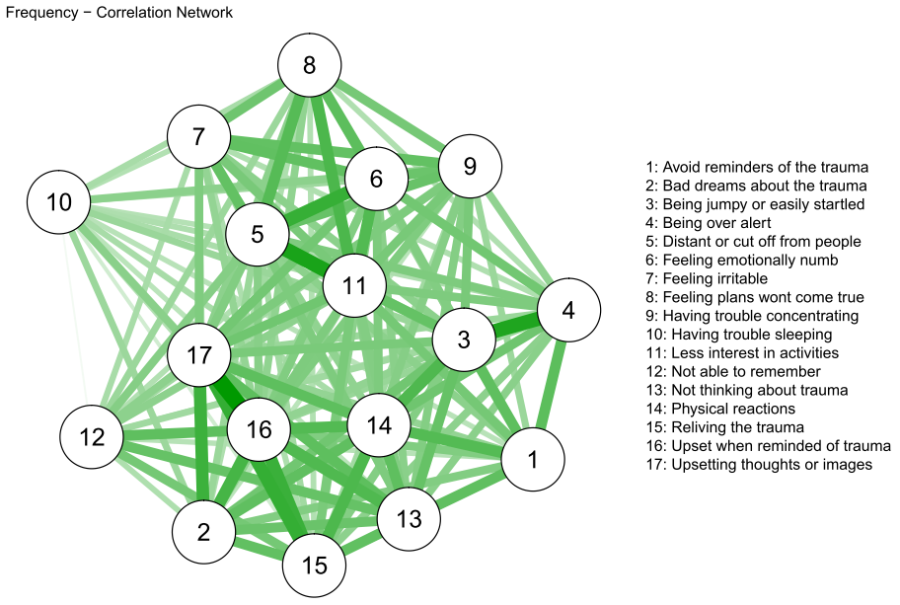
Correlation network

Slide 55
Correlation network
We automatically obtain the largest edge by setting details = TRUE
g1a <- qgraph(FreqCors, layout = "spring", labels = TRUE, nodeNames = labs, title = "Frequency - Correlation Network", legend.cex = 0.5, details = TRUE)

Slide 56
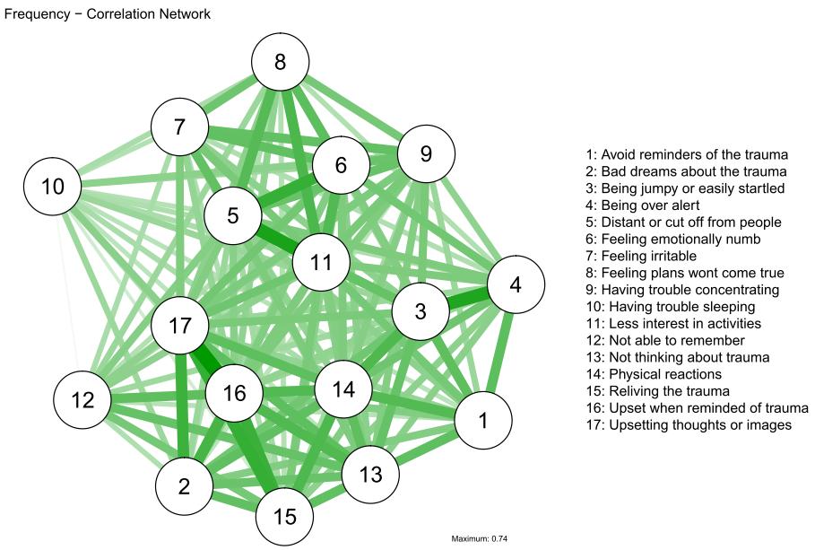
Correlation network

Slide 57
Correlation network
We can change the layout to a circle shape via layout = "circle"
g1b <- qgraph(FreqCors, layout = "circle")

Slide 58
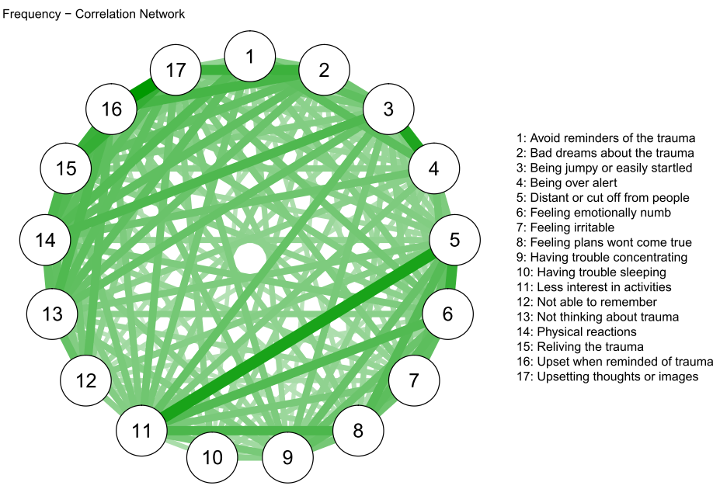
Correlation network

Slide 59
Partial correlation network
In our second network, edges are partial correlations by setting graph = "pcor"
Note that our data may not actually meet the requirements to compute partial correlations
g2 <- qgraph(FreqCors, layout = "spring", graph = "pcor")

Slide 60
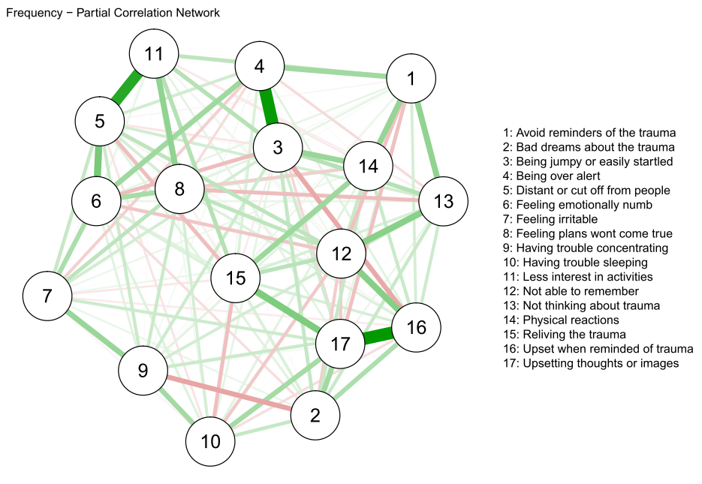
Partial correlation network

Slide 61
Regularised Graphical Gaussian Model
In our third network, we employ regularisation via the graphical lasso (gLasso) via graph = “EBICglasso"
Because regularisation depends on the sample size, we also need to specify our N:
g3 <- qgraph(FreqCors, layout = "spring", graph = ”EBICglasso", sampleSize = nrow(FreqBaseline))

Slide 62
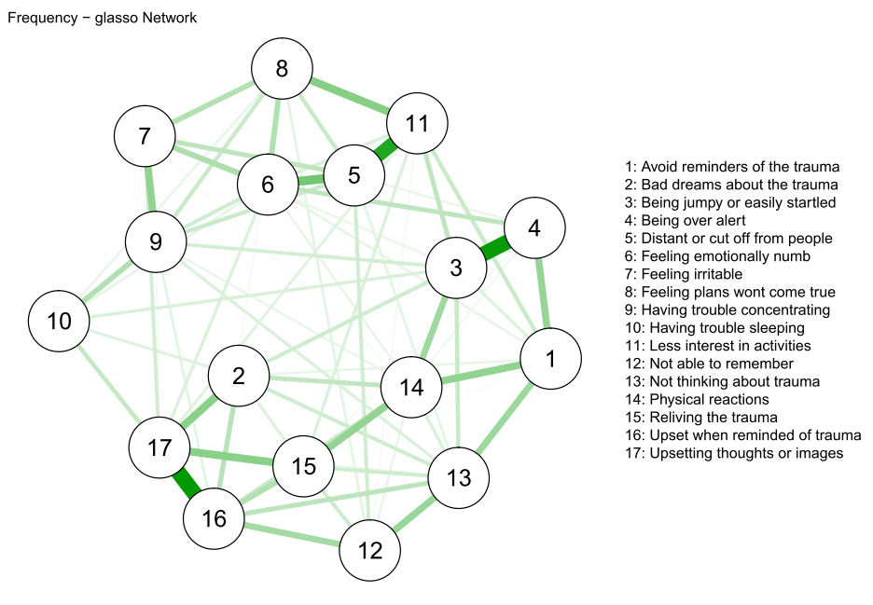
Regularised Graphical Gaussian Model

Slide 63
Regularised Graphical Gaussian Model
Let's look at the sparse GGM weights matrix or adjacency matrix
g3mat <- getWmat(g3)

Slide 64
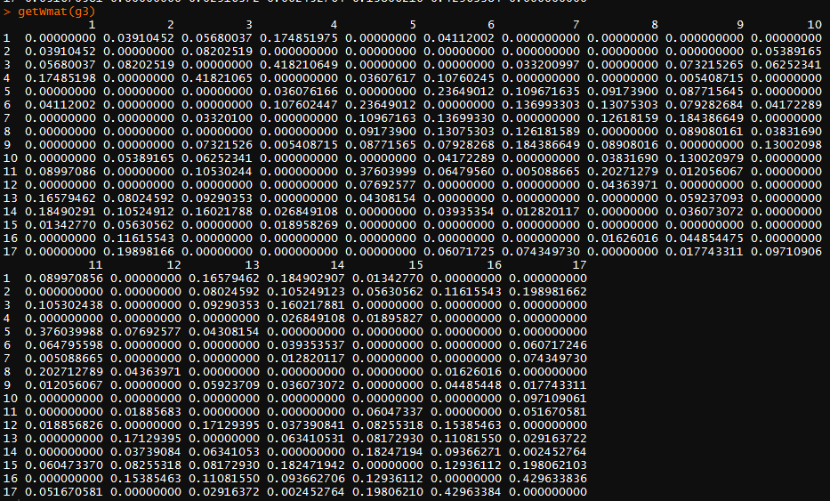
Weights matrix

Slide 65
Regularised Graphical Gaussian Model
Now let's compare the correlation and weights matrices of the data
The average edge in our correlation network is 0.34, in the sparse GGM network 0.05
mean(g3mat) # 0.05025167
FreqCors3 <- FreqCors
diag(FreqCors3) <-0
mean(FreqCors3) # 0.3413089

Slide 66
Matrix comparison

Slide 67
Plot all together
With the averageLayout function, we can constrain all node positions to be equal
L <- averageLayout(g1,g2,g3)
pdf("Networks.pdf", width = 10, height=7)
qgraph(g1, layout = L)
qgraph(g2, layout = L)
qgraph(g3, layout = L)
dev.off()

Slide 68
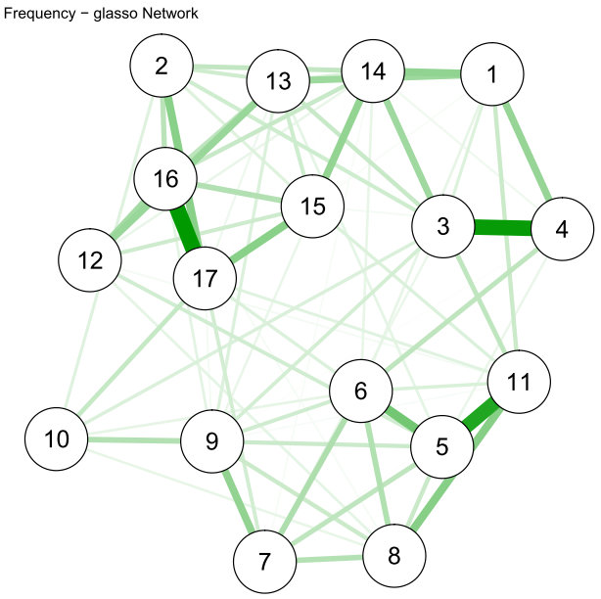

Slide 69
Regularised network: Ising Model
In our fourth network, we dichotomize symptoms and then estimate an Ising Model that requires binary data
FB2 <- FreqBaseline
colnames(FB2)<- c(1:17)
FB2[, 1:17] <- sapply(FB2[, 1:17], as.numeric)
FB2[[1]][FB2[[1]]==2] <- 1 # dichotomize the scale FB2[[1]][FB2[[1]]==3] <- 4
FB2[[2]][FB2[[2]]==2] <- 1
FB2[[2]][FB2[[2]]==3] <- 4
...

Slide 70
Regularised network: Ising Model
First we need to deal with missing data
FB2 <- na.omit(FB2) # N = 358 instead of 359
PTSDising <- IsingFit(FB2, family="binomial", plot = F, progressbar = T )
PTSDisingplot <- qgraph(PTSDising$weiadj, layout = L, title = "Frequency - Ising Model", vsize = 8)

Slide 71
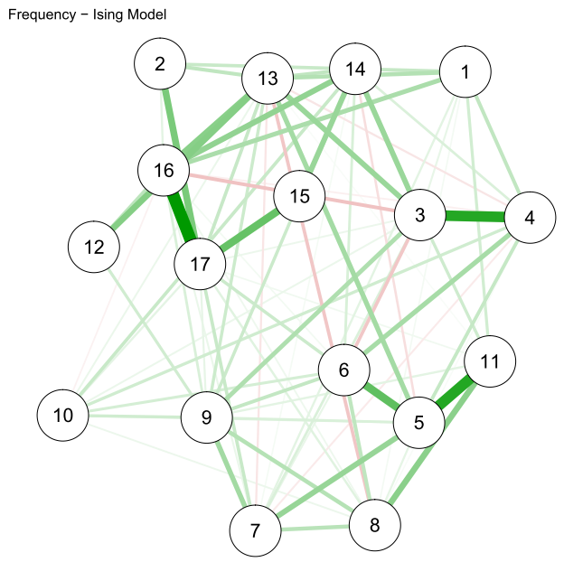
Comparison GGM vs. Ising Model

Slide 72
Comparison GGM vs. Ising Model
We can correlate the edges of the two networks to obtain a similarity coefficient (note: this is not a "proper" comparison test)
cor(getWmat(g3)[lower.tri(getWmat(g3))], PTSDising$weiadj[lower.tri(PTSDising$weiadj)], method="spearman") #0.74

Slide 73
Comparison GGM vs. Ising Model
Note that GGM edges are standardized (-1 to +1); this is not the case in the Ising Model

Slide 74
Missing data
In the Ising model, you run logistic regressions: no missing data allowed / possible
In the GGM, missing data are not a statistical problem: you can estimate the GGM with what we call “complete pairwise observations“ (e.g. see https://osf.io/nm9cv/ p. 13 bottom)

Slide 75
Now it’s your turn!
Get the practical from www.adelaisvoranu.com/Oldenburg2018
Cor = cor(data)
qgraph(Cor, graph = "pcor", layout = "spring", cut = 0)
res = estimateNetwork(data, default = “pcor”)
plot(res, layout = “spring”, cut = 0)

