Slide 1
Network Modeling for Psychological
(and Attitudinal) Data
11/01/2017 – 12/01/2017 Oldenburg
Adela Isvoranu & Pia Tio
http://www.adelaisvoranu.com/Oldenburg2018

Slide 2
Workshop Overview
Thursday January 11
  Morning
    Introduction & Theoretical Foundation of Network Analysis
    Drawing Networks in R (part of practical)
  Afternoon
    Network Estimation (Markov Random Fields: Gaussian Graphical Model & Ising Model)
Friday January 12
  Morning
    Stability, Replicability & Challenges of Network Modeling
  Afternoon
    Advanced Methods (Network Comparison Test, Mixed Graphical Models, Latent Variable Network Modeling)

Slide 3
Workshop Overview
Thursday January 11
  Morning
    Introduction & Theoretical Foundation of Network Analysis
    Drawing Networks in R (part of practical)
  Afternoon
    Network Estimation and Inference (Markov Random Fields: Gaussian Graphical Model & Ising Model)
Friday January 12
  Morning
    Stability, Replicability & Challenges of Network Modeling
  Afternoon
    Advanced Methods (Network Comparison Test, Mixed Graphical Models, Latent Variable Network Modeling)
Each block is followed by a computer practical in R

Slide 4


With thanks to Sacha Epskamp and Eiko Fried for many of
these slides

Slide 5
Introduction Round

Slide 6
Adela Isvoranu
Position
  PhD @University of Amsterdam
Contact
  isvoranu.adela@gmail.com
Social Media
  twitter.com/adelaisvoranu
  facebook.com/groups/PsychologicalDynamics/
Website
  http://www.adelaisvoranu.com
Fields of interest
  Clinical Psychology & Psychiatry
  Psychometrics & Methodology
  Complexity
  Dynamical systems

Slide 7
Pia Tio
Position
  PhD @Tilburg University & @University of Amsterdam
Contact
  piatio@gmail.com
Fields of interest
  Clinical Psychology & Psychiatry
  Genetics & Ecology
  Clinical Psychology & Biology
  Statistics & Methods
  Psychological Theory

Slide 8
Introduction Round
Who are you?
What is your background?
What do you expect from this workshop?
How familiar are you with R?

Slide 9
Morning Session Overview
Introduction and Theoretical Foundation of Network Analysis
Part 1. Complexity & the network theory
Part 2. What are psychological constructs?
Part 3. Analogies to other fields
Part 4. Nomenclature & concepts
Part 5. Social network analysis
Part 6. Network psychometrics
Drawing Networks in R & Practical Session

Slide 10
Morning Session Overview
Introduction and Theoretical Foundation of Network Analysis
Part 1. Complexity & the network theory
Part 2. What are psychological constructs?
Part 3. Analogies to other fields
Part 4. Nomenclature & concepts
Part 5. Social network analysis
Part 6. Network psychometrics
Drawing Networks in R & Practical Session

Slide 11
Psychology as a Complex System
Psychological processes are increasingly understood as complex dynamical systems of interacting components
  Psychological
  Biological
  Sociological
  …
Recent literature (~10 years) moved away from static factor models, embracing this complexity

Slide 12
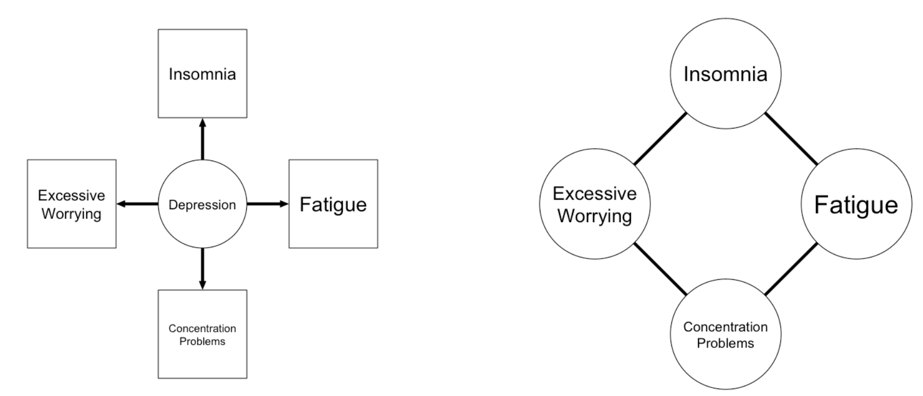
The Network Perspective of Psycho(patho)logy
Cramer, A. O. J., Waldorp, L., van der Maas, H., & Borsboom, D. (2010). Comorbidity: A Network Perspective. Behavioral and Brain Sciences, 33(2-3), 137– 150. doi: 10.1017/S0140525X09991567
Borsboom, D. (2017). A network theory of mental disorders. World Psychiatry, 16(1):5–13.

Slide 13
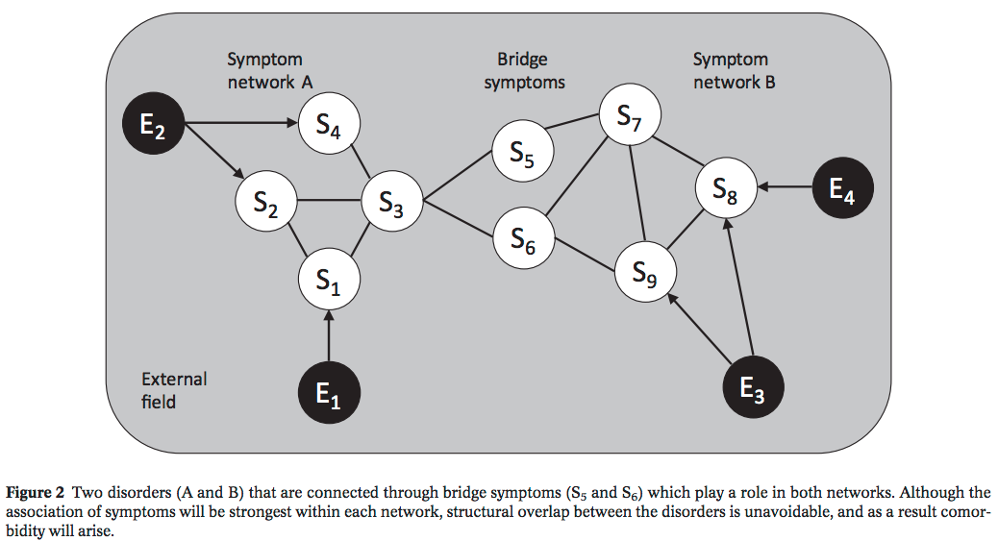
A Network Theory of Mental Disorders
Cramer, A. O. J., Waldorp, L., van der Maas, H., & Borsboom, D. (2010). Comorbidity: A Network Perspective. Behavioral and Brain Sciences, 33(2-3), 137– 150. doi: 10.1017/S0140525X09991567
Borsboom, D. (2017). A network theory of mental disorders. World Psychiatry, 16(1):5–13.

Slide 14
Consequences of the Network Perspective
Co-occurrence of symptoms, moods, personality aspects understood as emergent behavior
  Implication: symptom-based interventions possible
Every person is a different system
  Implication: personalized modeling and treatment
Possible to think in terms of attractor states with smooth or critical transitions
  Implication: dynamical models may lead to insight in optimal intervention
Analogies possible to many fields, including ecology, physics and virus models

Slide 15
Morning Session Overview
Introduction and Theoretical Foundation of Network Analysis
Part 1. Complexity & the network theory
Part 2. What are psychological constructs?
Part 3. Analogies to other fields
Part 4. Nomenclature & concepts
Part 5. Social network analysis
Part 6. Network psychometrics
Drawing Networks in R & Practical Session

Slide 16
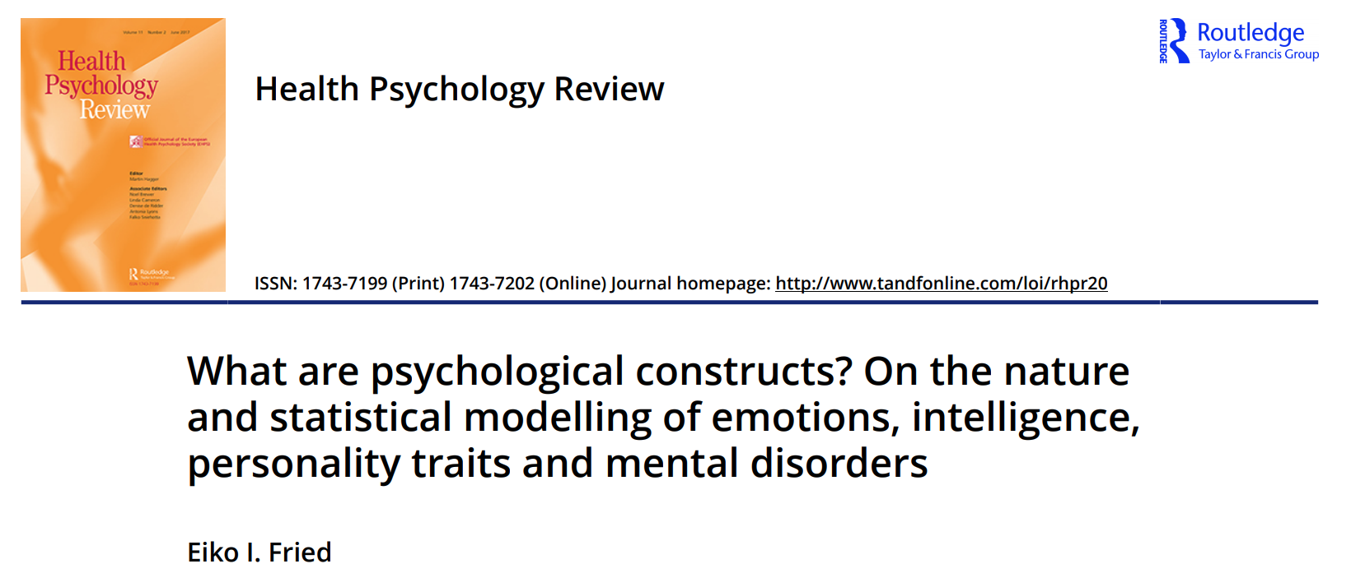
What are psychological constructs?
What are psychological constructs, such as cognitions, emotions, attitudes, personality characteristics and intelligence?
How are they best modelled statistically?

Slide 17
What are psychological constructs?
Natural Kinds
Social Kinds
Practical Kinds
Complex Kinds

Slide 18
Natural kinds
Categories discovered, not constructed
Unchanging and ahistoric entities
Sharp boundaries
Set of properties P necessary and sufficient for classification
  Emotions, Mental disorders, Personality characteristics
  Ekman & Cordaro: “emotions are discrete [and] can be distinguished fundamentally from one another" (2011, p. 364)
DOI | 10.3389/fpsyg.2015.00309

Slide 19
Natural kinds
Categories discovered, not constructed
Unchanging and ahistoric entities
Sharp boundaries
Set of properties P necessary and sufficient for classification
  Emotions, Mental disorders, Personality characteristics
  Ekman & Cordaro: “emotions are discrete [and] can be distinguished fundamentally from one another" (2011, p. 364)
DOI | 10.3389/fpsyg.2015.00309

Slide 20


Social kinds
Idea that psychological construcs are socially constructed
Emotions, personality facets, higher order abilities, and mental disorders are produced, not discovered
Berger & Luckmann (1996): all knowledge,
even the most basic insight,
is derived and maintained by social interactions
Szasz: all mental disorders are socially constructed

Slide 21

Practical kinds
Emotions, personality characteristics or mental disorders should be judged in terms of practical scientific success, not whether they correspond to an independent reality
Constructs should be useful for the question at hand
SES

Slide 22
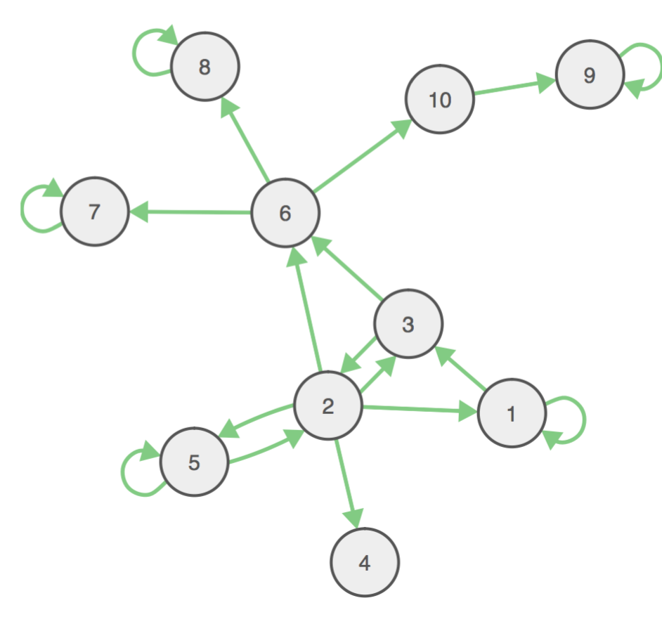
Complex kinds
Homeostatic property clusters (HPC; Richard Boyd, 1991)
Biological features occur together because presence of one tends to favor presence of another
Depression: symptoms
co-occur because the
presence of one likely
leads to others.
Boyd, R. (1991). Realism, anti-foundationalism and the enthusiasm for natural kinds. Philosophical Studies, 127–148.

Slide 23
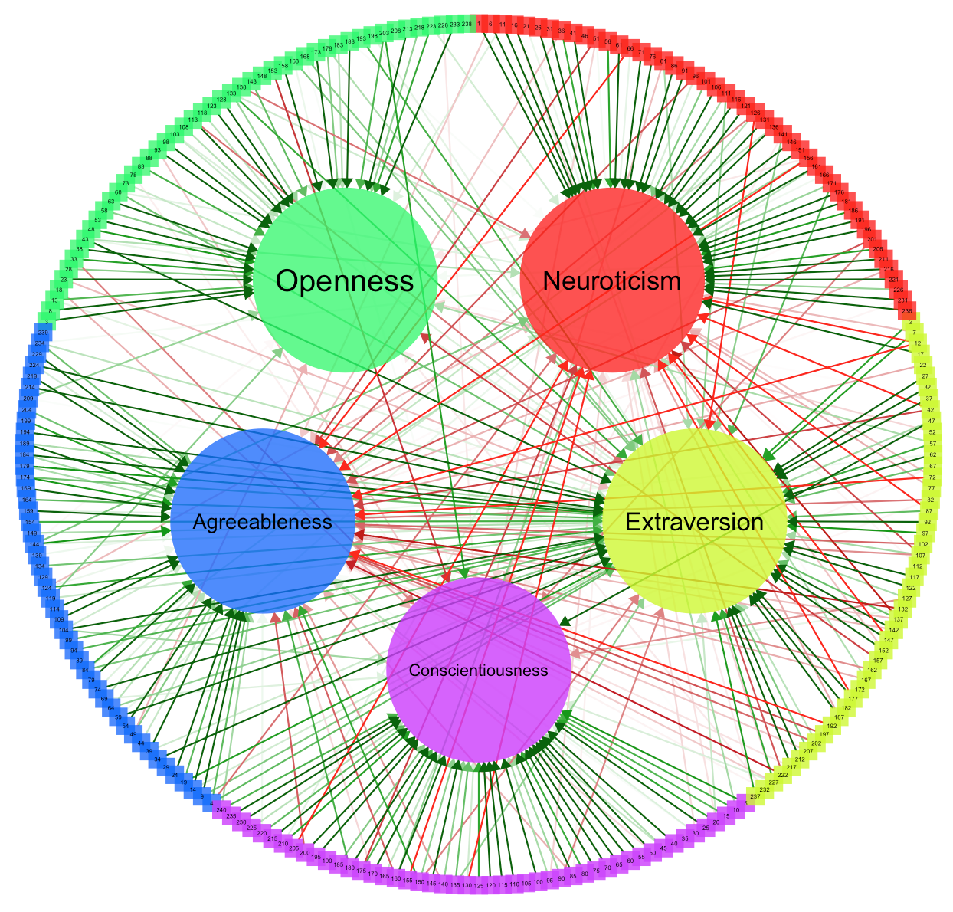
Personality traits
DATA | R, library("psych"), data("big5")

Slide 24
Personality
Sacha Epskamp: give SEM1 students ‘psych’ package BFI data
Task them to find best fitting factor model
  http://sachaepskamp.com/files/BFI.pdf

Slide 25
Literature
Wide range of psychological constructs have been proposed to be homeostatic property clusters:
  Personality characteristics (Rene Mõttus, Angelique Cramer, Giulio Costantini)
  Attitudes (Jonas Dalege)
  Intelligence (“Mutualism model”; Han van der Maas, Rogier Kievit)
  Mental disorders (Denny Borsboom, Kenneth Kendler, Eiko Fried)

Slide 26
What are psychological constructs?
Natural Kinds
Practical Kinds
Social Kinds
Complex Kinds

Slide 27
Statistical Models
The question what a psychological construct is guides the type of statistical model that is appropriate.

Slide 28
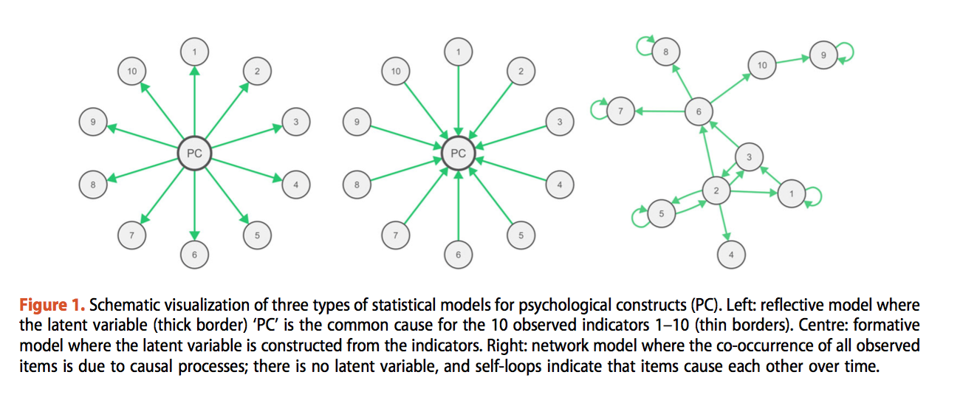
Statistical Models
The question what a psychological construct is guides the type of statistical model that is appropriate.

Slide 29
Statistical Models
The question what a psychological construct is guides the type of statistical model that is appropriate.

Slide 30
Statistical Models
The question what a psychological construct is guides the type of statistical model that is appropriate.

Slide 31
Conclusion
  Specify theory before you move to modeling; consider what model is appropriate for your theory
  Distinguish theoretical from statistical model
  Network and common cause theory (e.g. of mental disorders) are competing, and cannot both be fully true at the same time
    Although hybrid situations are feasible
  Network and latent variable models are mathematically interchangeable and complementary, not competing

Slide 32
Morning Session Overview
Introduction and Theoretical Foundation of Network Analysis
Part 1. Complexity & the network theory
Part 2. What are psychological constructs?
Part 3. Analogies to other fields
Part 4. Nomenclature & concepts
Part 5. Social network analysis
Part 6. Network psychometrics
Drawing Networks in R & Practical Session

Slide 33
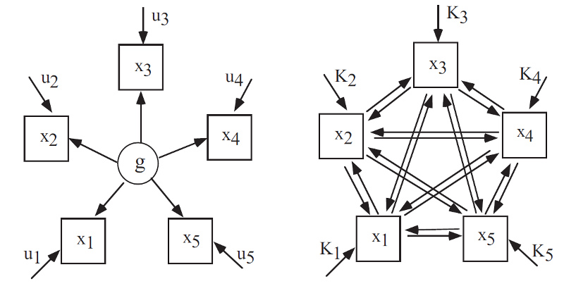
Analogy 1: Ecology
General factor
Mutualism
van der Maas, H. L., Dolan, C. V., Grasman, R. P., Wicherts, J. M., Huizenga, H. M., & Raijmakers, M. E. (2006). A dynamical model of general intelligence: The positive manifold of intelligence by mutualism. Psychological Review, 113(4), 842–861. doi: 10.1037/ 0033-295X.113.4.842

Slide 34
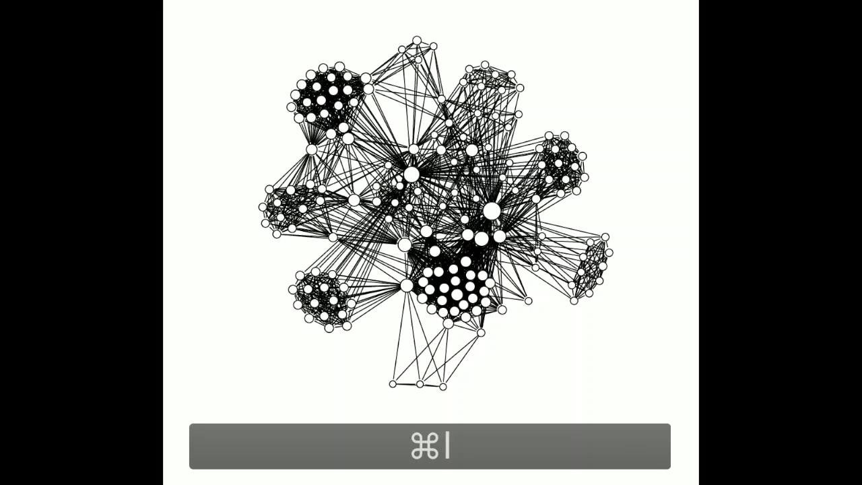
Analogy 2: Psychopathology as a Virus

Slide 35
Prevent the Outbreak
http://vax.herokuapp.com/game

Slide 36
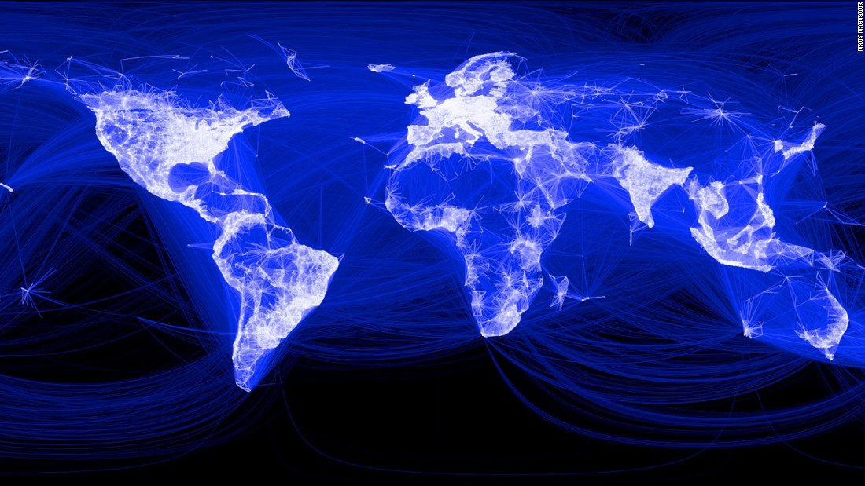

Slide 37
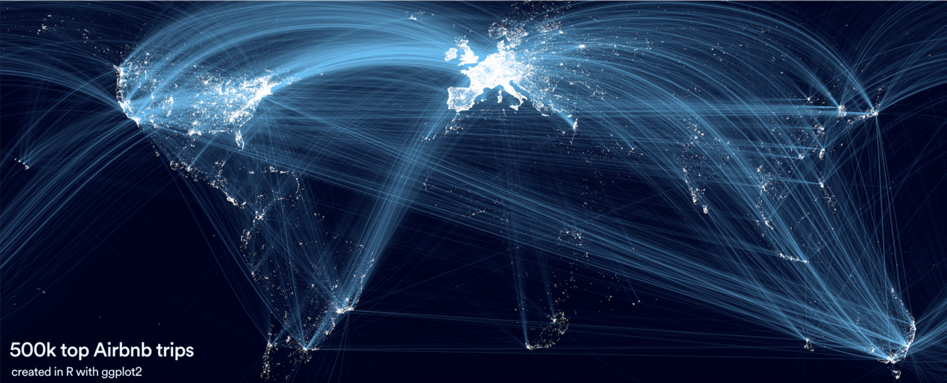

Slide 38
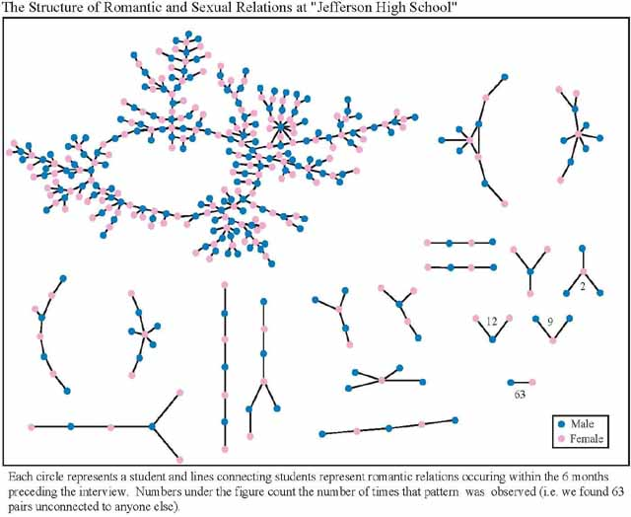
Bearman, P. S., Moody, J., & Stovel, K. (2004). Chains of affection: The structure of adolescent romantic and sexual networks. American journal of sociology, 110(1), 44-91.

Slide 39
Mapping out Psychological Complexity
Networks may be useful structures in mapping out psychological complexity. However, to study such a network, we first need to construct it
Dynamical systems modeling: theoretical expertise can be used to form a network “from the ground up”
Network psychometrics: network estimation methodology has been worked out
  While originating from the network perspective, now more often used as exploratory hypothesis generating methods

Slide 40

Break

Slide 41
Morning Session Overview
Introduction and Theoretical Foundation of Network Analysis
Part 1. Complexity & the network theory
Part 2. What are psychological constructs?
Part 3. Analogies to other fields
Part 4. Nomenclature & concepts
Part 5. Social network analysis
Part 6. Network psychometrics
Drawing Networks in R & Practical Session

Slide 42
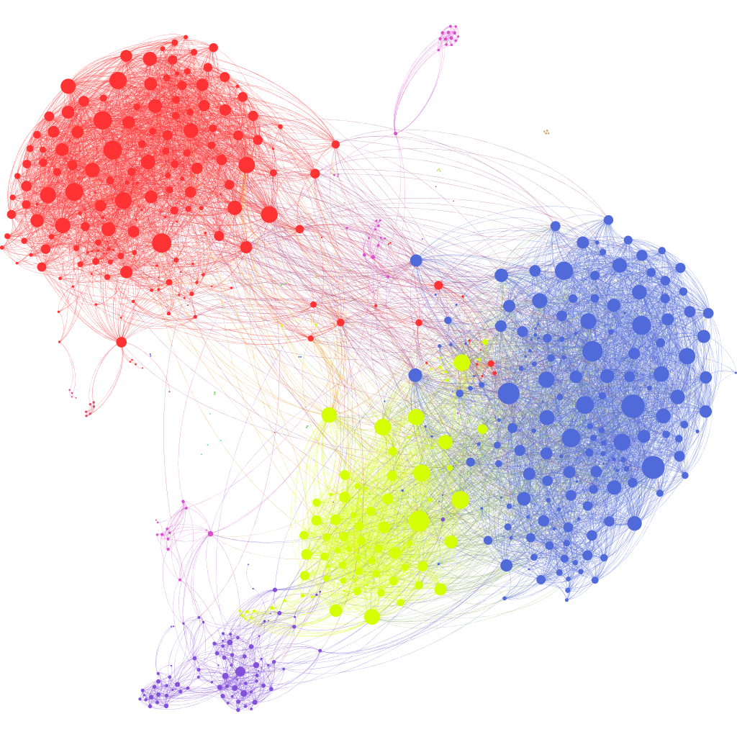
Networks
A network is a set of nodes connected by a set of edges
  Nodes are also called vertices
  Edges are also called links
  Networks are also called graphs
A node represents an entity
  People
  Cities
  Symptoms
  Psychological construct

Slide 43
Networks
An edge represents some connection between two nodes
Friendship / contact
Distance
Comorbidity
Causality
Interaction

Slide 44
Networks
Edges can be weighted or unweighted

Slide 45
Signs of edges
Edges can have a sign (positive or negative)

Slide 46
Networks
Networks can be directed or undirected

Slide 47
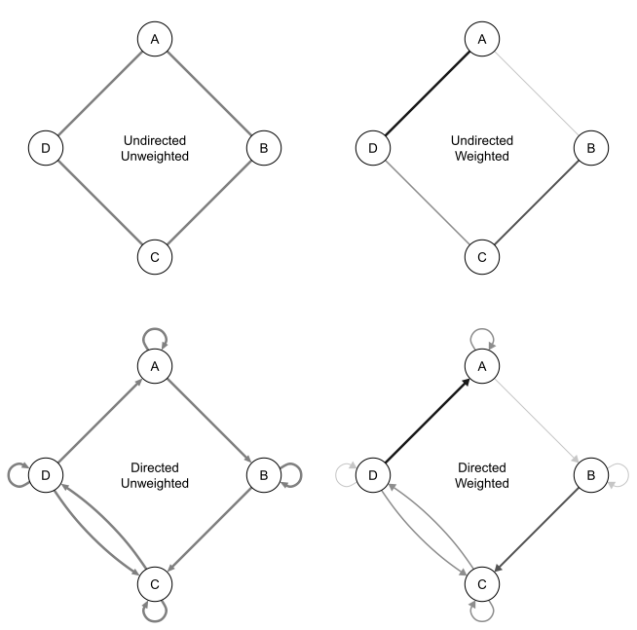
Networks

Slide 48
Mathematical notation of graphs
A graph G is considered an ordered pair of a set N of nodes and a set E edges:
G = {N,E}
N = {1, 2, 3}
E = {(1, 2), (2, 3), (3, 1)}

Slide 49
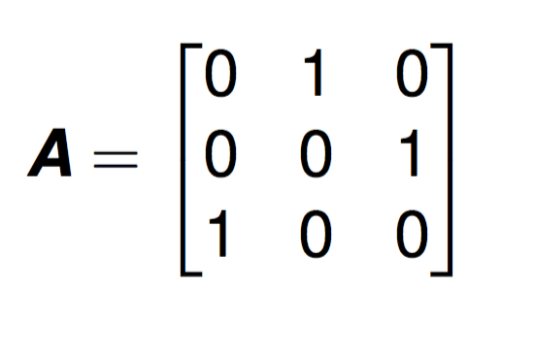
Adjacency matrix
An adjacency matrix is a square N×N matrix in which each element is 0 or 1; N is the number of nodes.
If there is a 1 in row i and column j it means there is an edge from node i to node j
A 0 denotes that there is no edge

Slide 50
Adjacency matrix
To
1 2 3
From
1
2
3

Slide 51
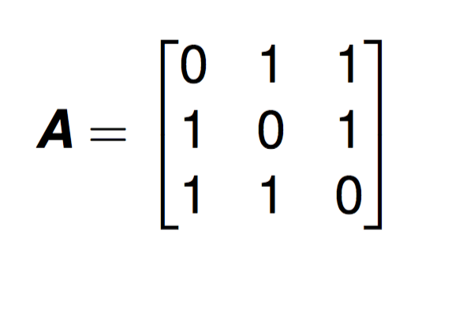
Adjacency matrix
Undirected networks are encoded with a symmetrical adjacency matrix

Slide 52
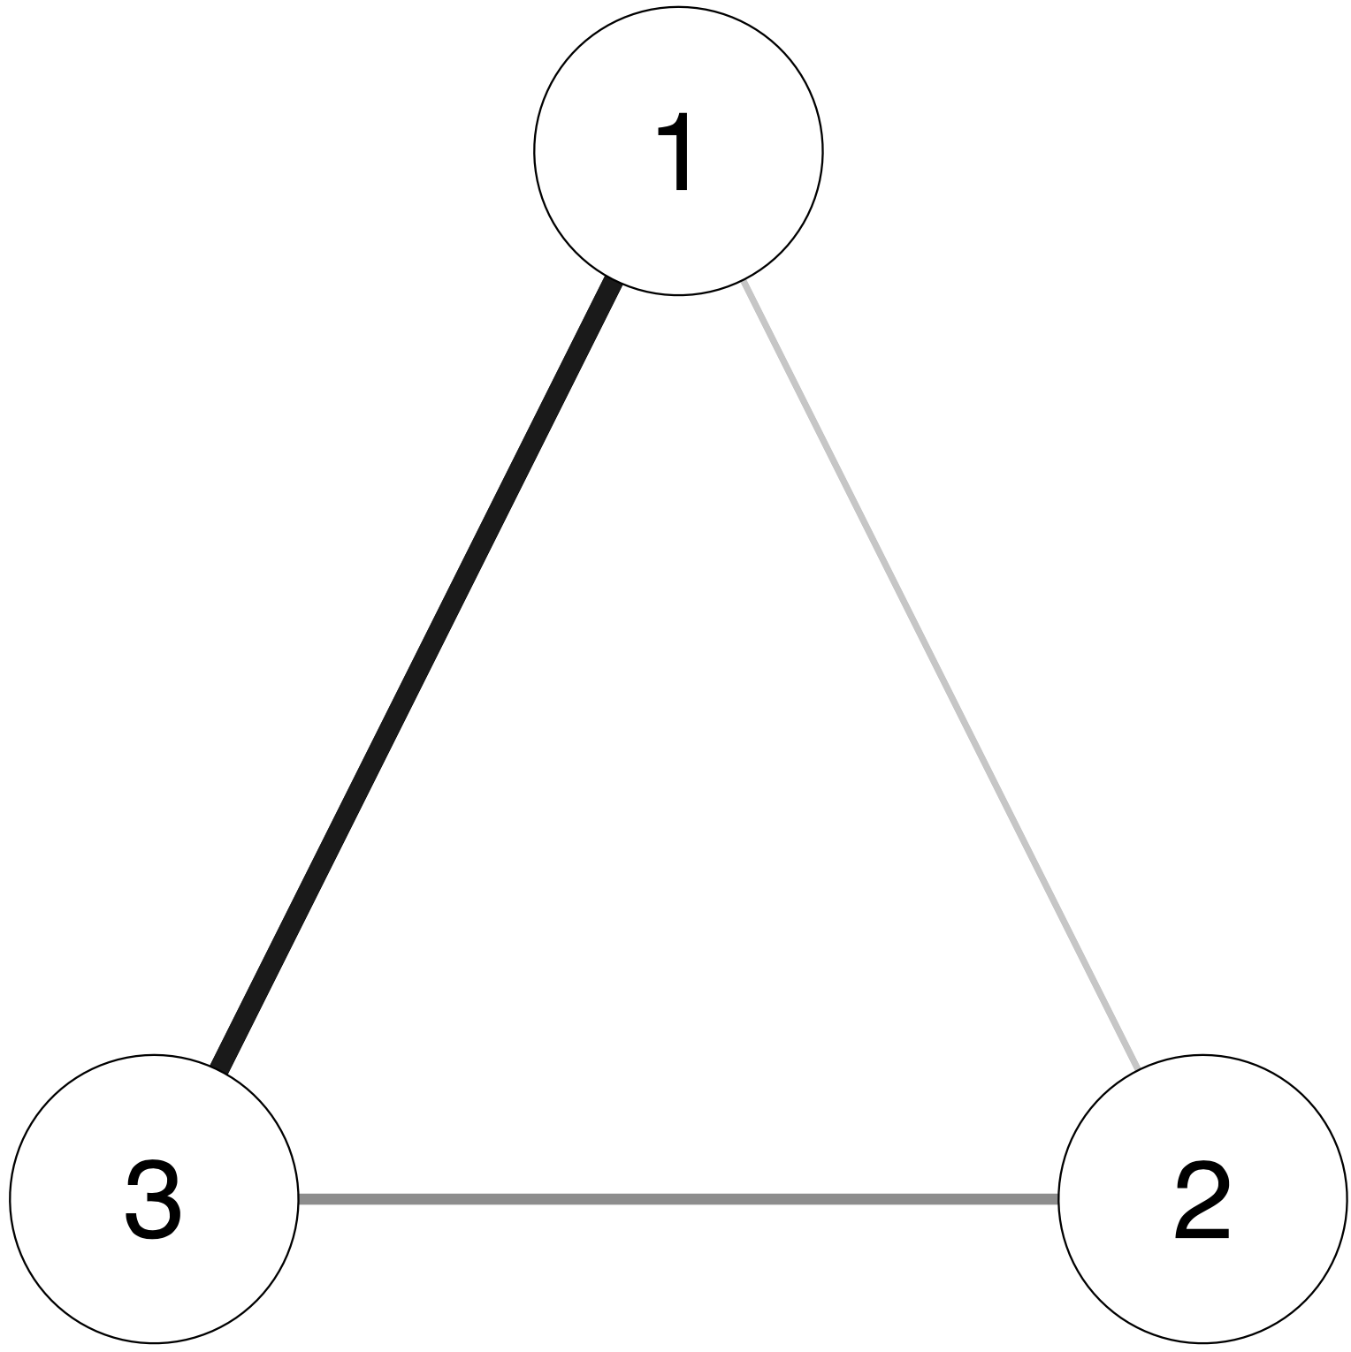
Weights matrix
Weighted networks are encoded with a weights matrix (adjacency with other values than 0 and 1)
0 1 3
1 0 2
3 2 0

Slide 53
Morning Session Overview
Introduction and Theoretical Foundation of Network Analysis
Part 1. Complexity & the network theory
Part 2. What are psychological constructs?
Part 3. Analogies to other fields
Part 4. Nomenclature & concepts
Part 5. Social network analysis
Part 6. Network psychometrics
Drawing Networks in R & Practical Session

Slide 54
Network Inference
Once a network has been estimated, descriptive measures can be computed to investigate and summarize the structure
Global inference
  E.g., Small-worldness, density
  Mostly still in development for weighted networks and MRFs
Local inference (nodes/edges)
  E.g., node centrality, edge centrality, clustering
  Many researchers in psychology focused on node centrality to obtain most “important” nodes
Important: These measures were developed in in networks such as railway and social networks; real interpretation in psychological networks is not trivial

Slide 55
Small-world networks
The famous paper of Watts and Strogatz (1998)—already cited 34,477 times—describes the “small world” principle that frequently occurs in natural graphs.
High clustering
  My friends are also typically friends
Low average path length
  “Six degrees of separation”
Watts, D. J., & Strogatz, S. H. (1998). Collective dynamics of ‘small-world’ networks. nature, 393(6684), 440-442.

Slide 56
Small-world networks

Slide 57
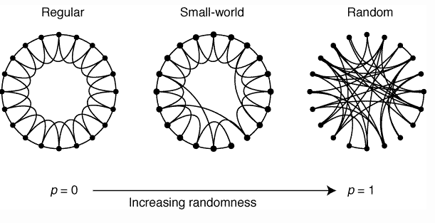
Small-world networks
A graph exhibits a small world structure if it has a much higher clustering than a random graph of the same dimensions while still having a low APL. The small world index captures this in a single number. Higher than 3 is typically interpreted as a small world
Watts, D. J., & Strogatz, S. H. (1998). Collective dynamics of ‘small-world’ networks. nature, 393(6684), 440-442.

Slide 58
Borsboom, D., Cramer, A. O., Schmittmann, V. D., Epskamp, S., & Waldorp, L. J. (2011). The small world of psychopathology. PloS one, 6(11), e27407.

Slide 59
Centrality
Centrality measures aim to assess the connectedness of a given variable with all other variables in the network
Many exist for unweighted networks; fewer for weighted networks
  Opsahl, T., Agneessens, F., & Skvoretz, J. (2010). Node centrality in weighted networks: Generalizing degree and shortest paths. Social networks, 32(3), 245-251.

Slide 60
Centrality
Node strength / degree centrality
  Most common & intuitive
  Sum of all absolute edge weights of edges connected to a given node
Closeness
Betweenness

Slide 61
Shortest paths
Closeness & Betweenness rely on the concept of shortest paths
  A shortest path is the most efficient way to get from one node to another (e.g., google maps)

Slide 62
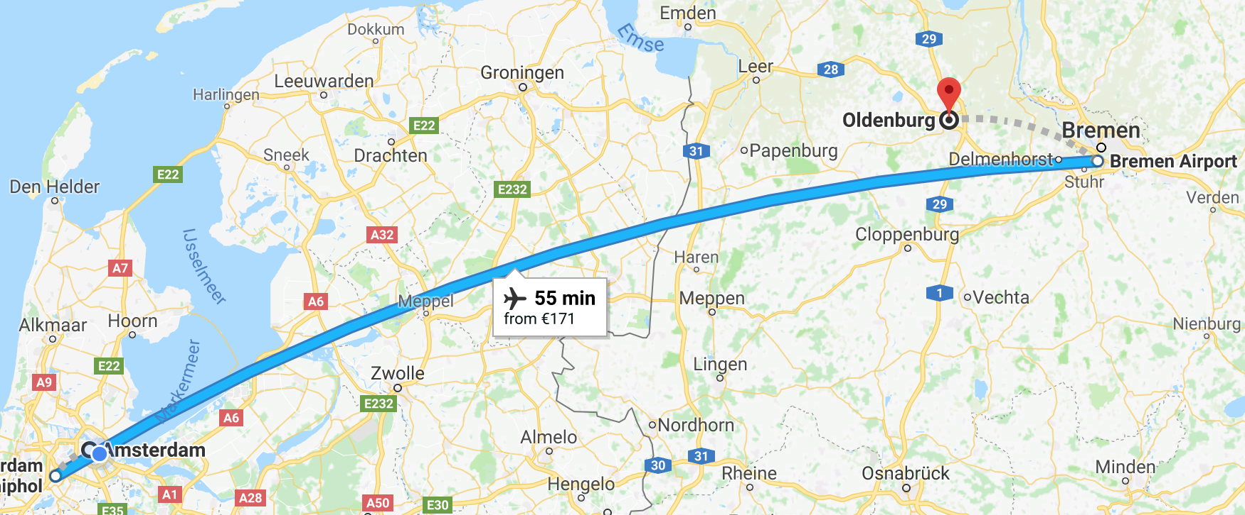
Shortest paths

Slide 63
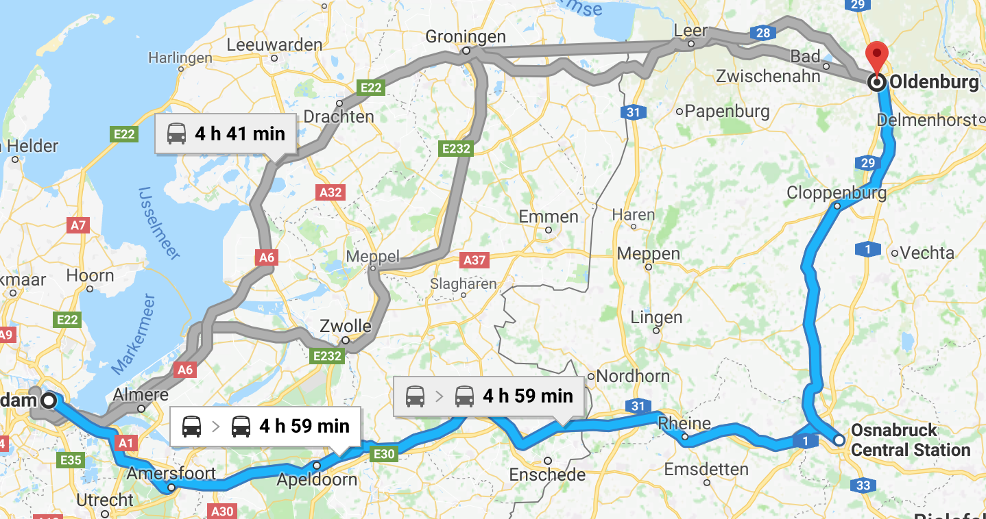
Shortest paths

Slide 64
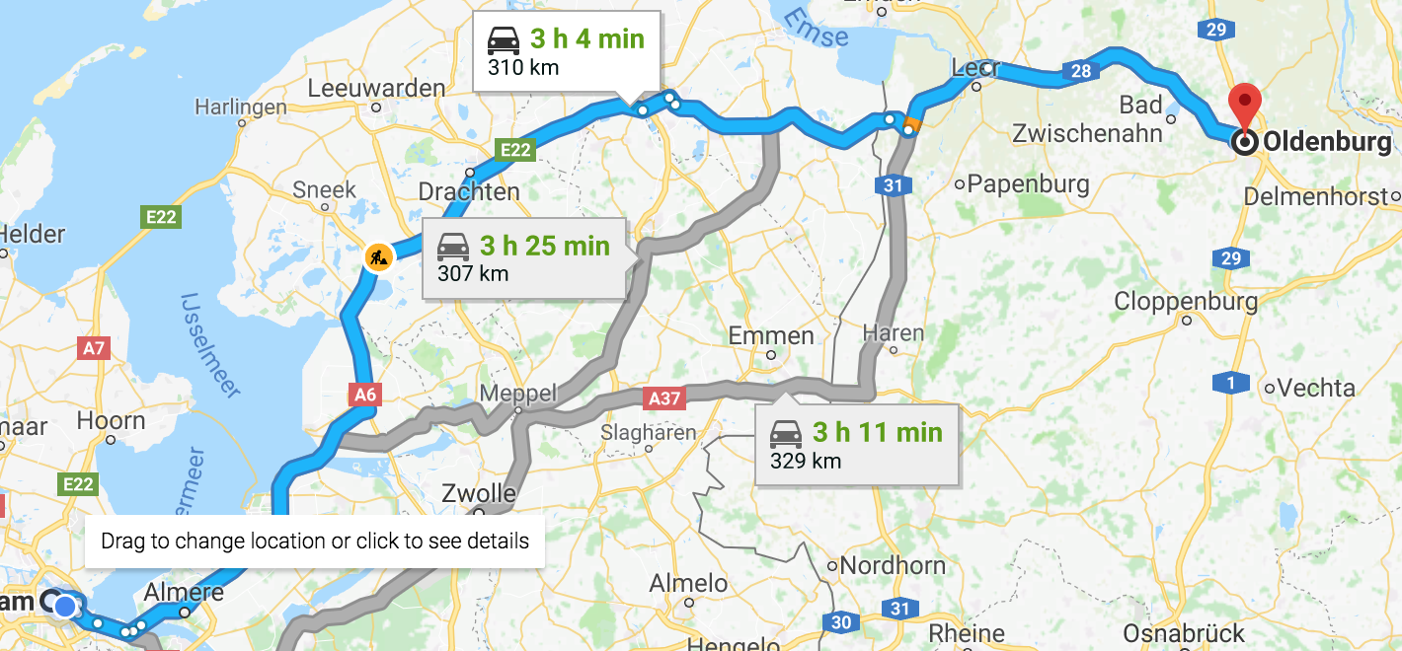
Shortest paths

Slide 65
Shortest paths
Closeness & Betweenness rely on the concept of shortest paths
  A shortest path is the most efficient way to get from one node to another (e.g., google maps)
Edges first translated to length
  The length of an edge is the inverse of the absolute edge weight
Next, Dijkstra’s algorithm can be used to compute the shortest paths between all pairs of nodes in a network
Closeness is inversely related to the sum of all shortest path lengths from one node to all other nodes
Betweenness is related to how often a node is in shortest paths between other nodes

Slide 66
Centrality
Node strength: how strongly a node is directly connected
  A central railway station is one with many railways running through it
Closeness: how strongly a node is indirectly connected
  A central railway station is one located in the center of the country, close to all destinations
Betweenness: how well one node connects other nodes
  A central railway station is an important transit station
Often similar results, but not necessarily

Slide 67
Node Strength / Degree
Notes:
DSM network: depression and anxiety.
The node strength or degree showed that the item “insomnia” was the highest central node in this network, which makes a lot of sense because this is a very important problem people suffering from depression and anxiety have.

Slide 68
Closeness

Slide 69
Betweenness

Slide 70
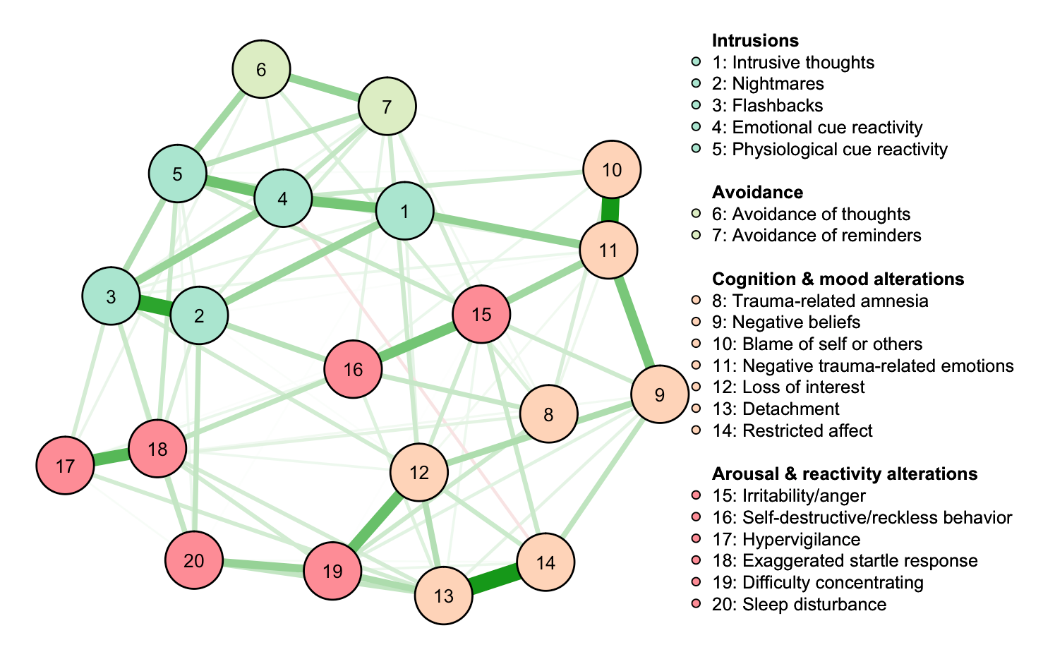
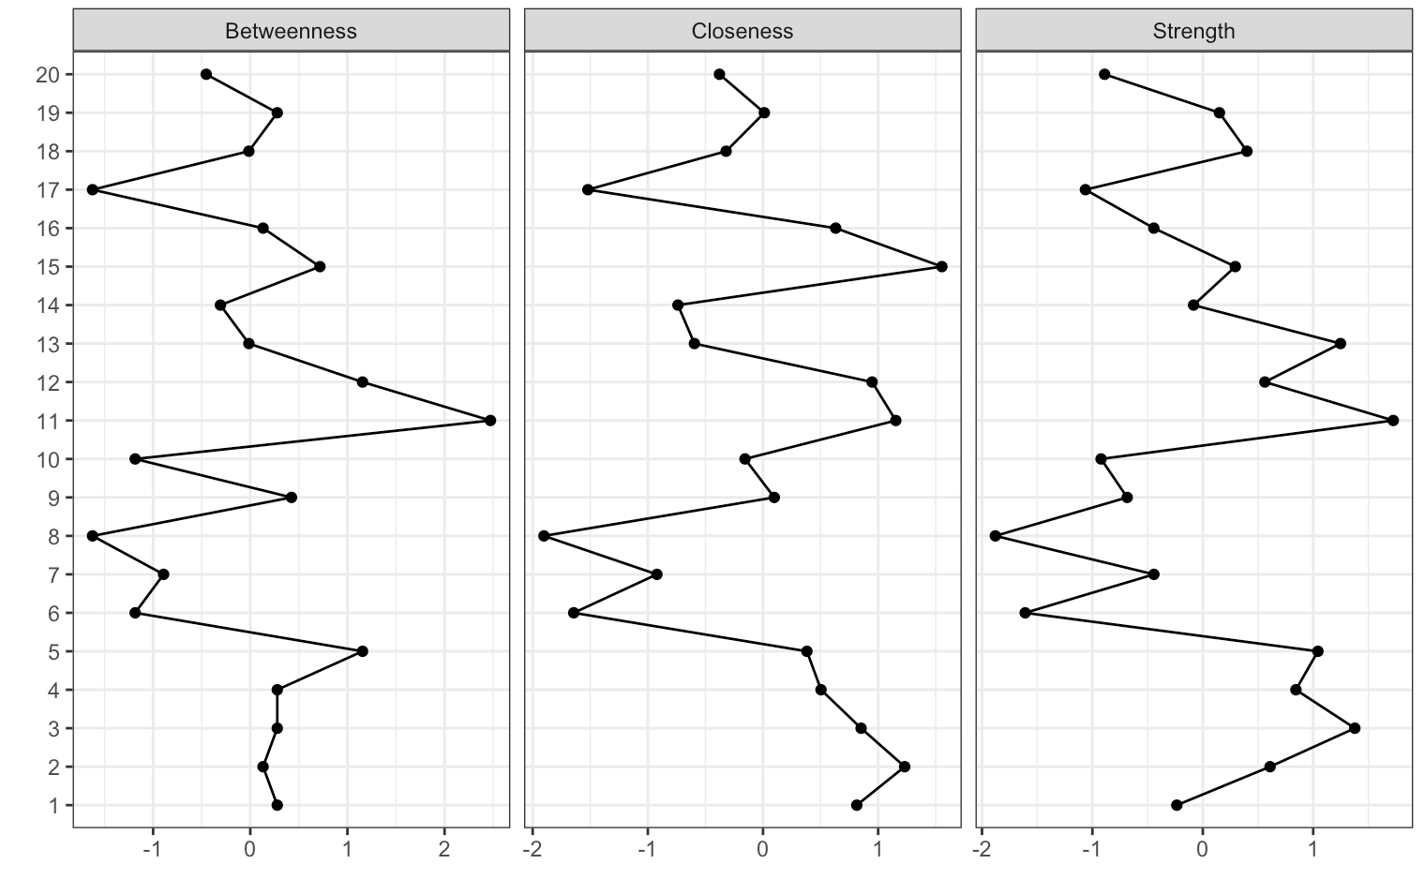
Centrality
Important: When estimating psychological networks centrality
differences need to be tested for accuracy and stability. More about this tomorrow!

Slide 71
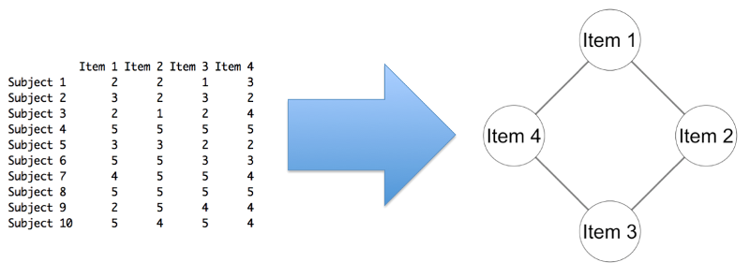
What is the Structure of Psychology?

Slide 72
Morning Session Overview
Introduction and Theoretical Foundation of Network Analysis
Part 1. Complexity & the network theory
Part 2. What are psychological constructs?
Part 3. Analogies to other fields
Part 4. Nomenclature & concepts
Part 5. Social network analysis
Part 6. Network psychometrics
Drawing Networks in R & Practical Session

Slide 73
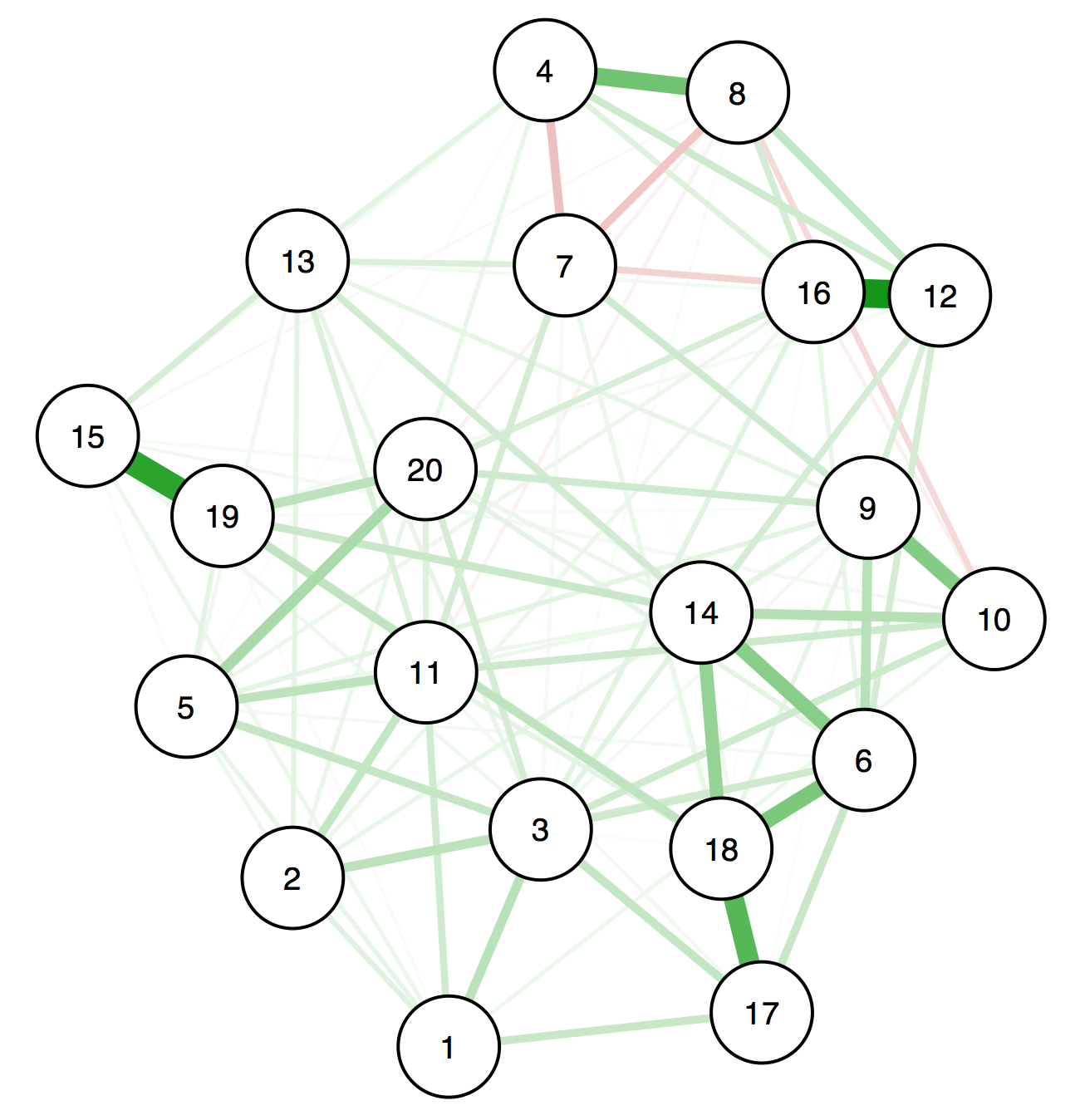
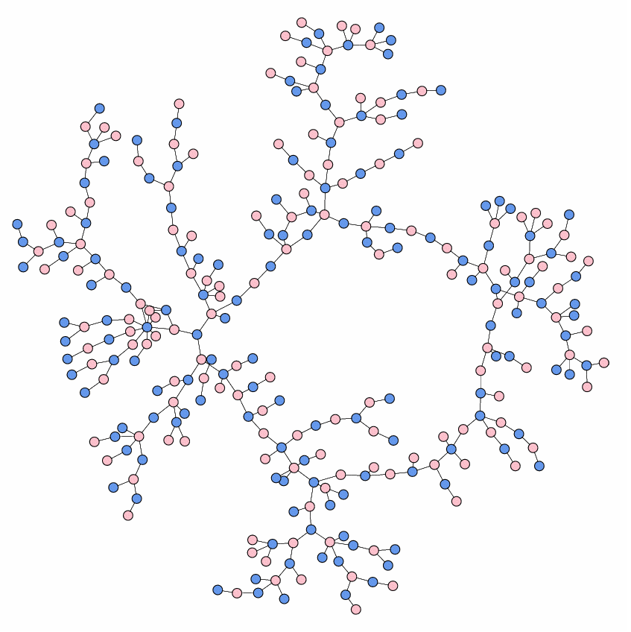
Network Psychometrics
Psychological networks differ from networks of many other disciplines in one very fundamental aspect
  Edges are not observed and need to be estimated
  (https://arxiv.org/abs/1604.08462)

Slide 74
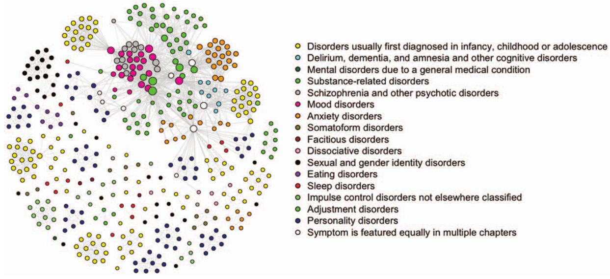
Comorbidity
DOI 10.1371/journal.pone.0027407

Slide 75
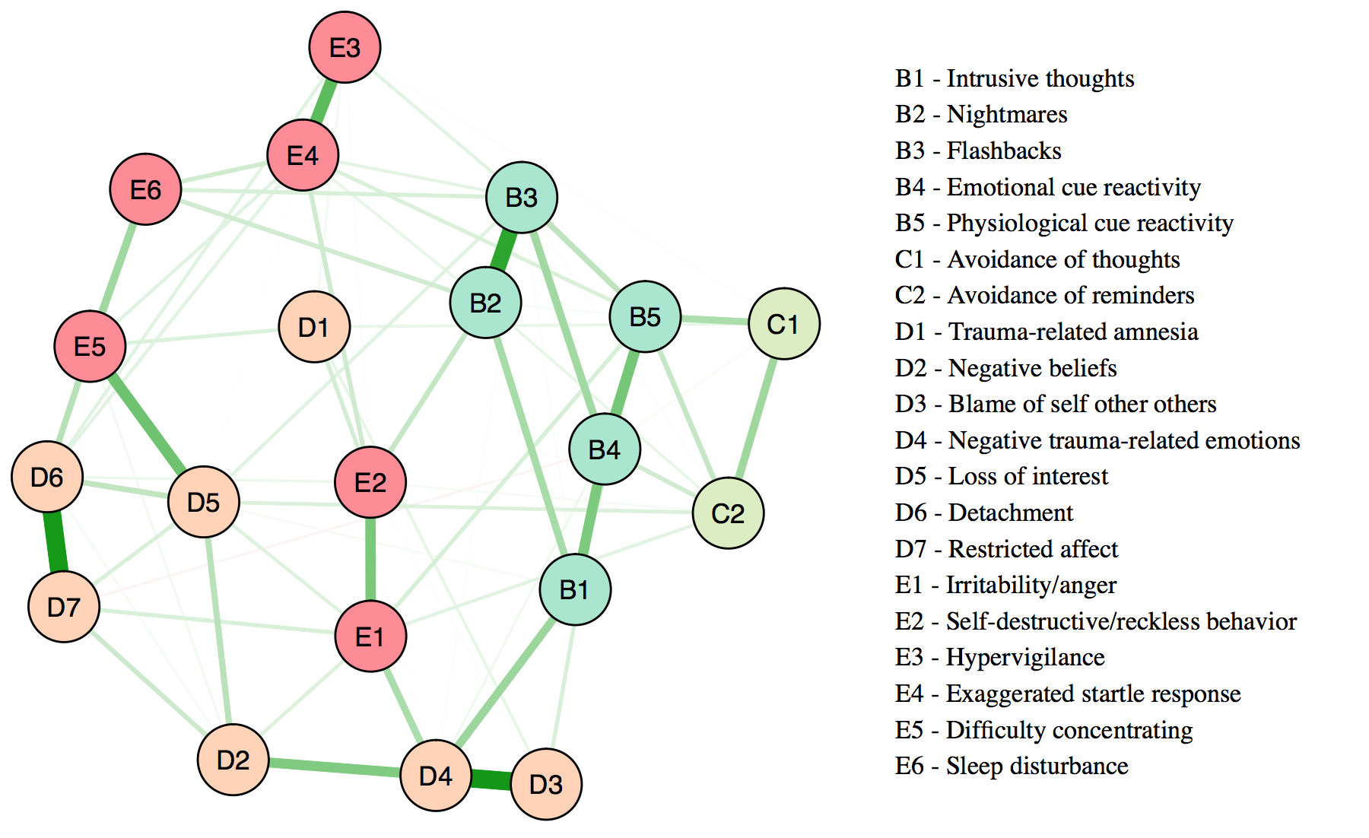
PTSD
DOI 10.1016/j.janxdis.2016.11.008

Slide 76
Substance abuse networks
10.1016/j.drugalcdep.2016.02.005; D2—withdrawal, D5—monopolizes time

Slide 77
Bereavement
DOI 10.1037/abn0000028

Slide 78
Psychosis
DOI 10.1093/schbul/sbw049

Slide 79
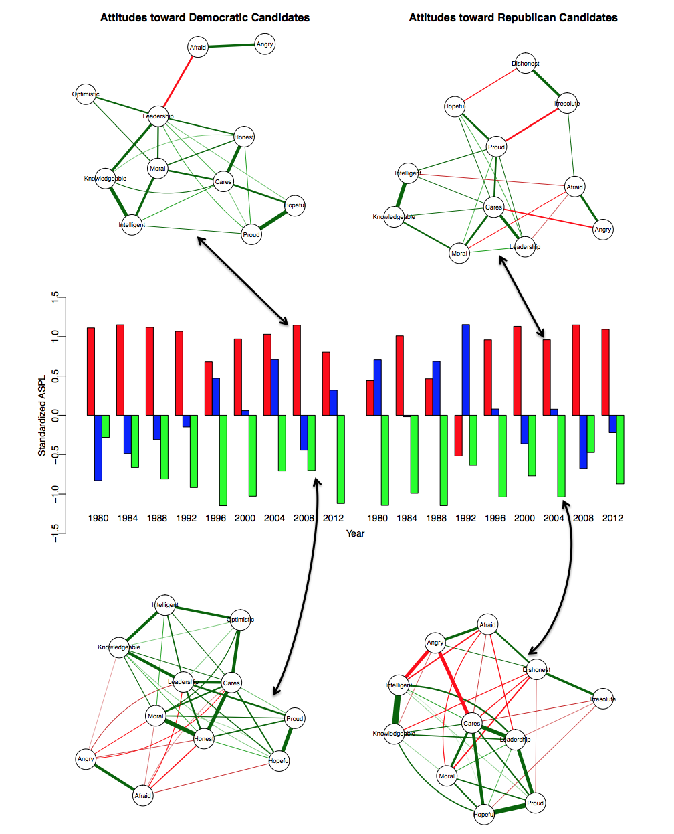
Attitudes
arXiv:1705.00193

Slide 80
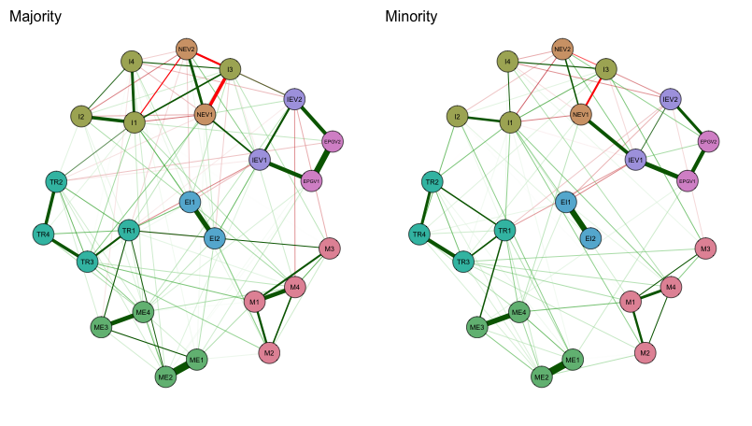
Multicultural classroom dynamics
Abacioglu et al. (under review)

Slide 81
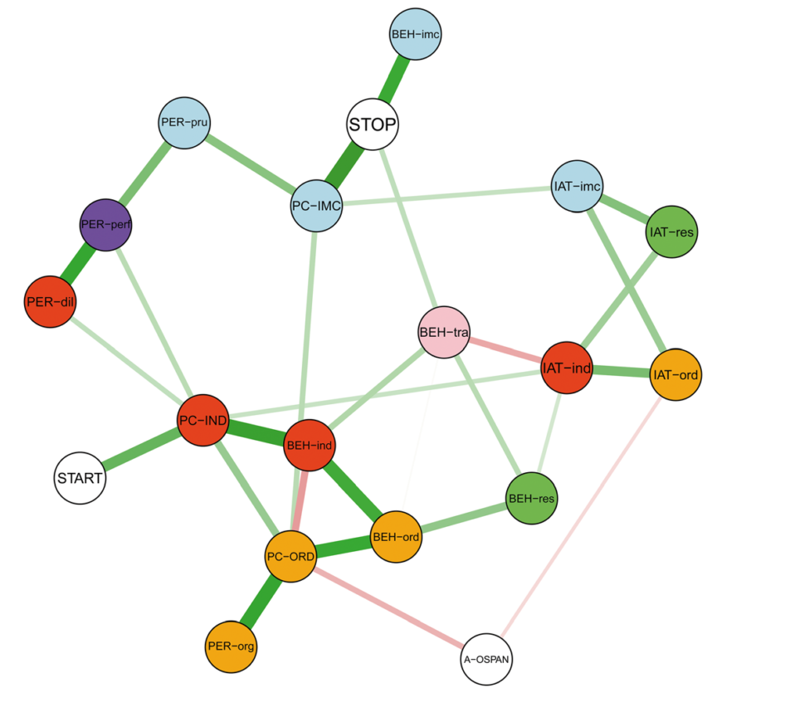
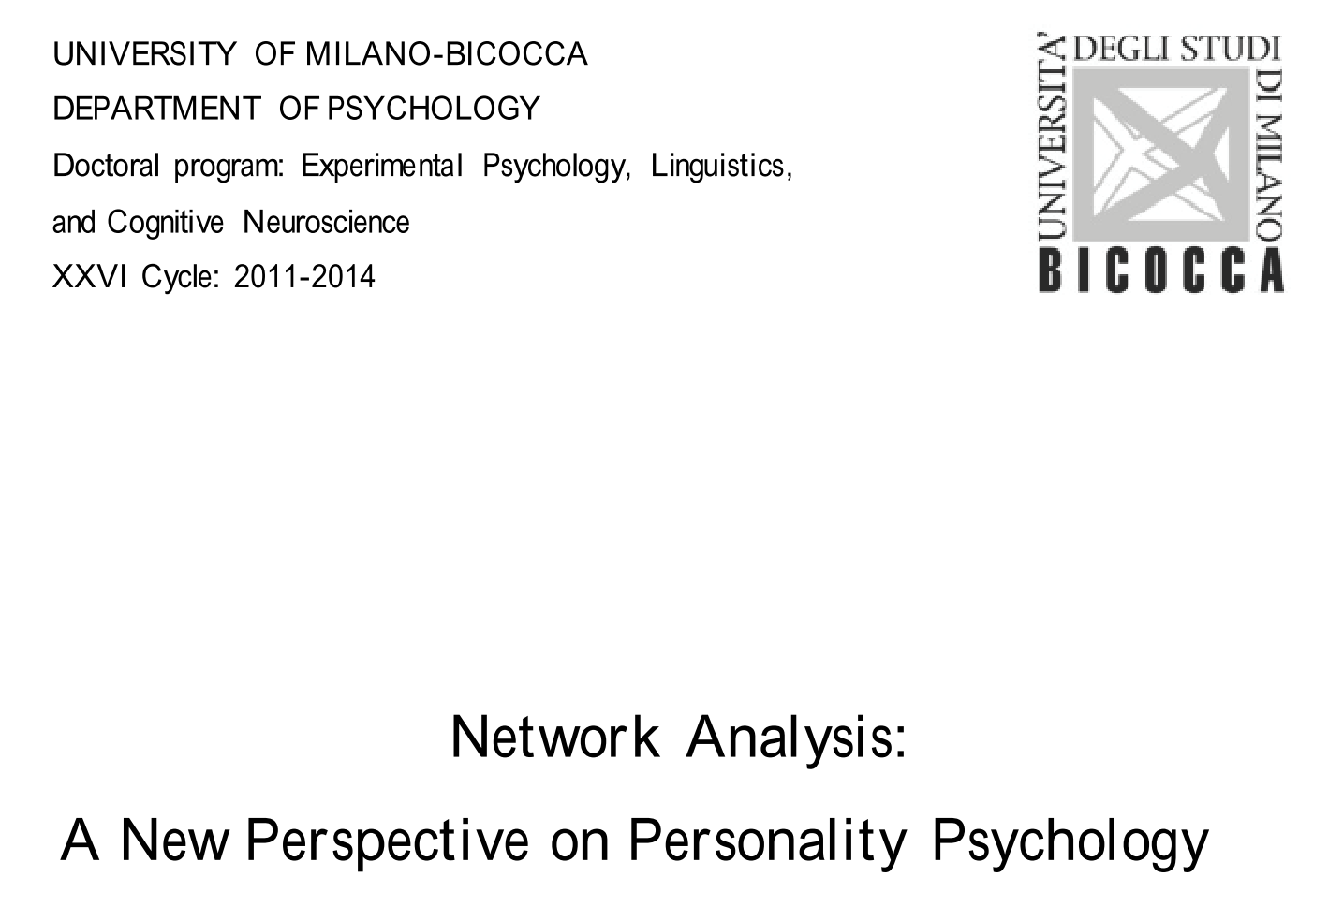
Personality
PhD of Giulio Costantini
DOI 10.1002/per.2014

Slide 82
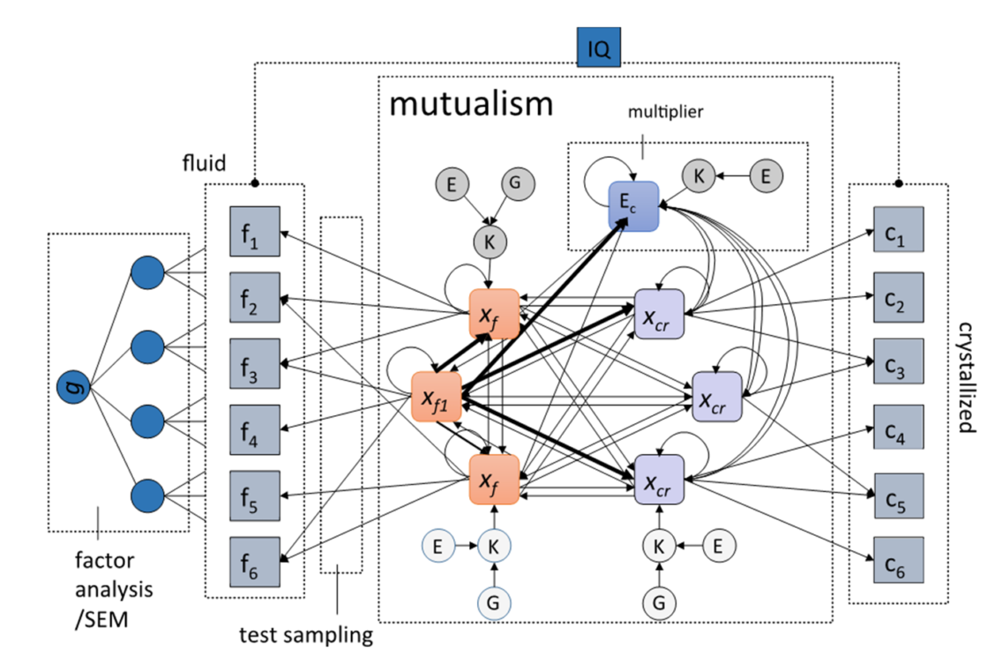
Intelligence
Preprint by Han van der Maas
10.20944/preprints201701.0107.v1

Slide 83
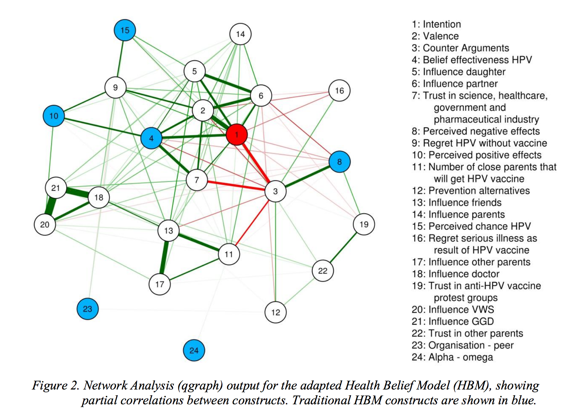
Vaccination Intents

Slide 84
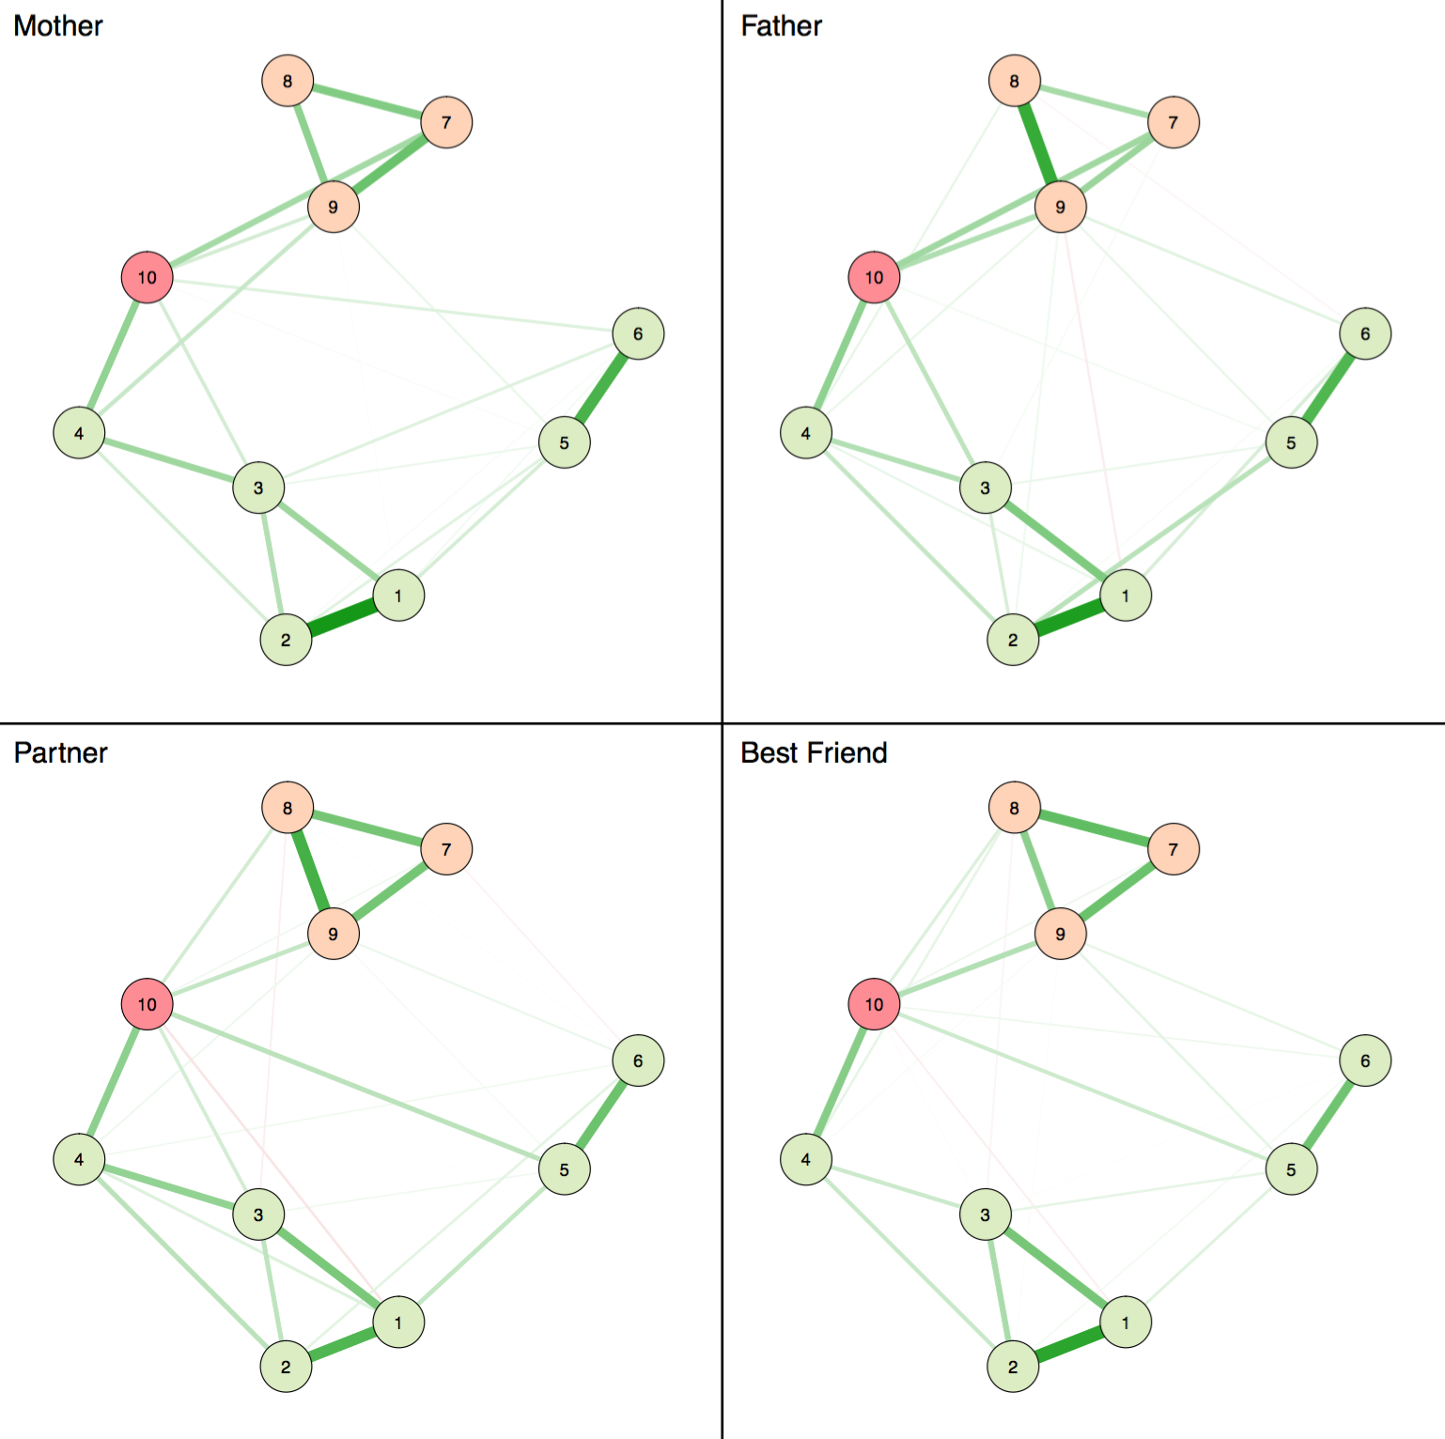
Attachment

Slide 85
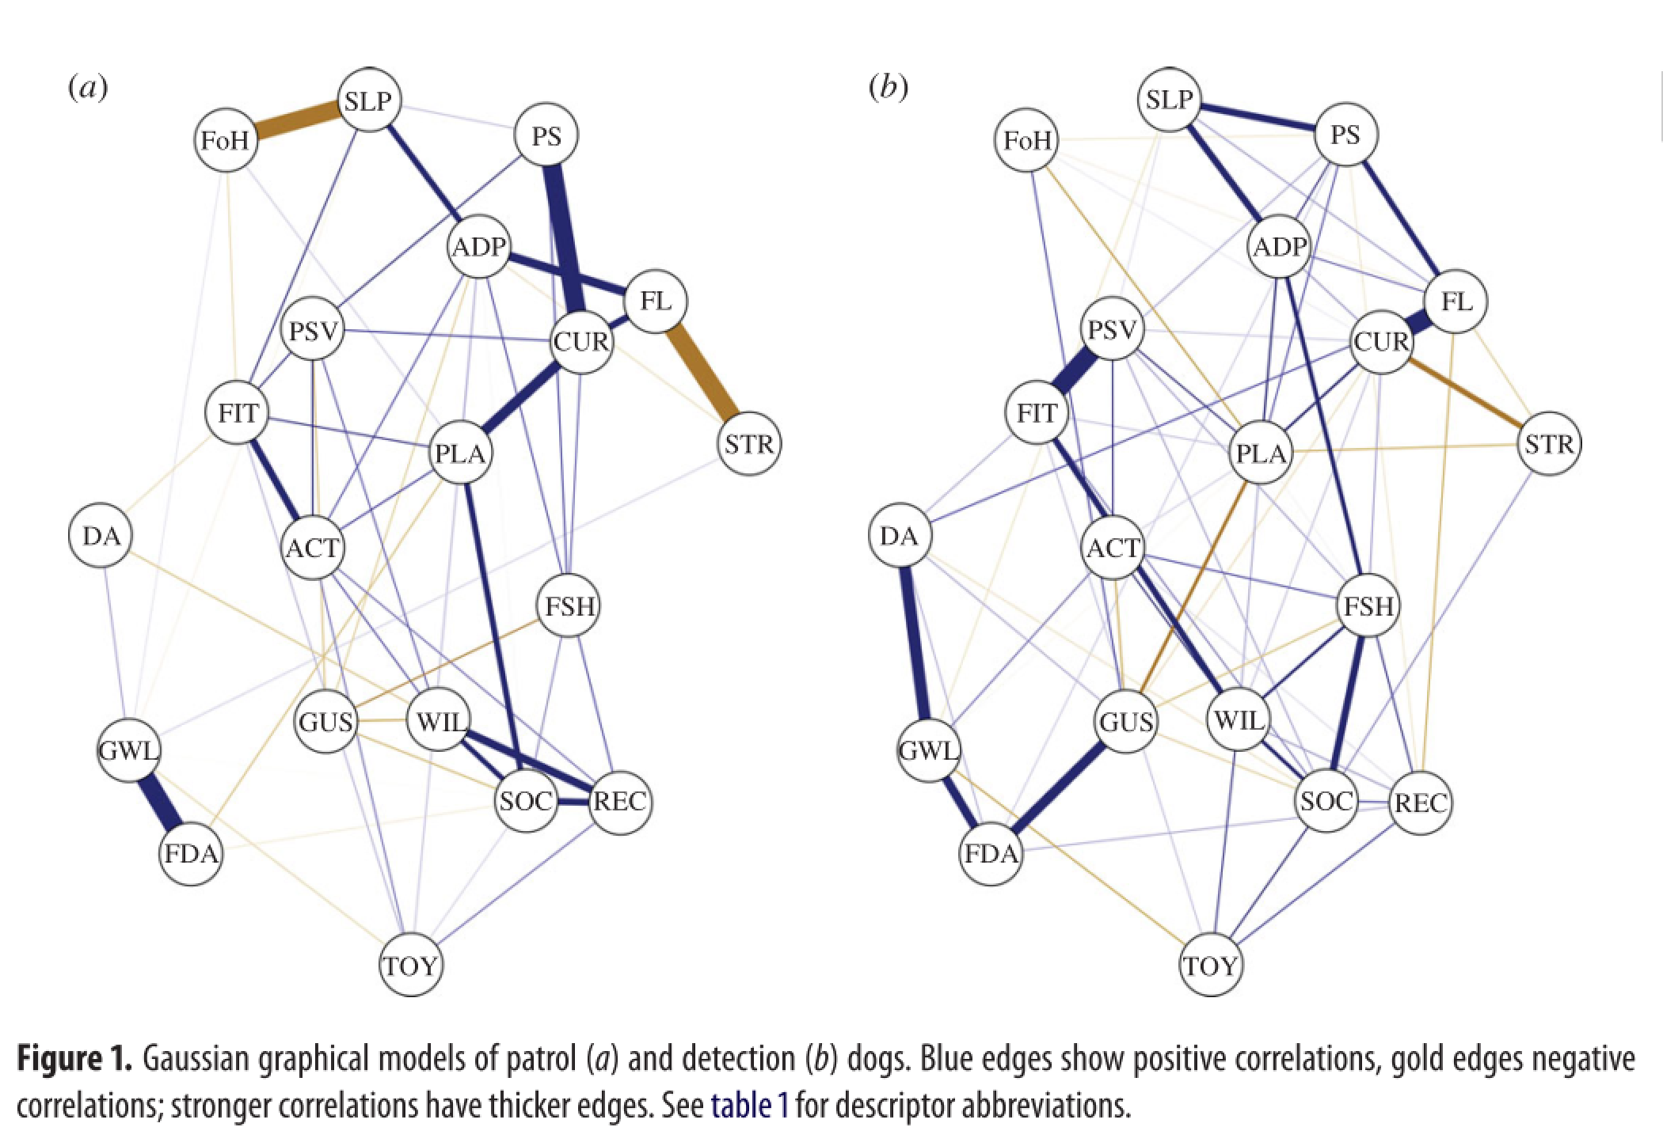
10.1098/rsos.160268

Slide 86


Slide 87
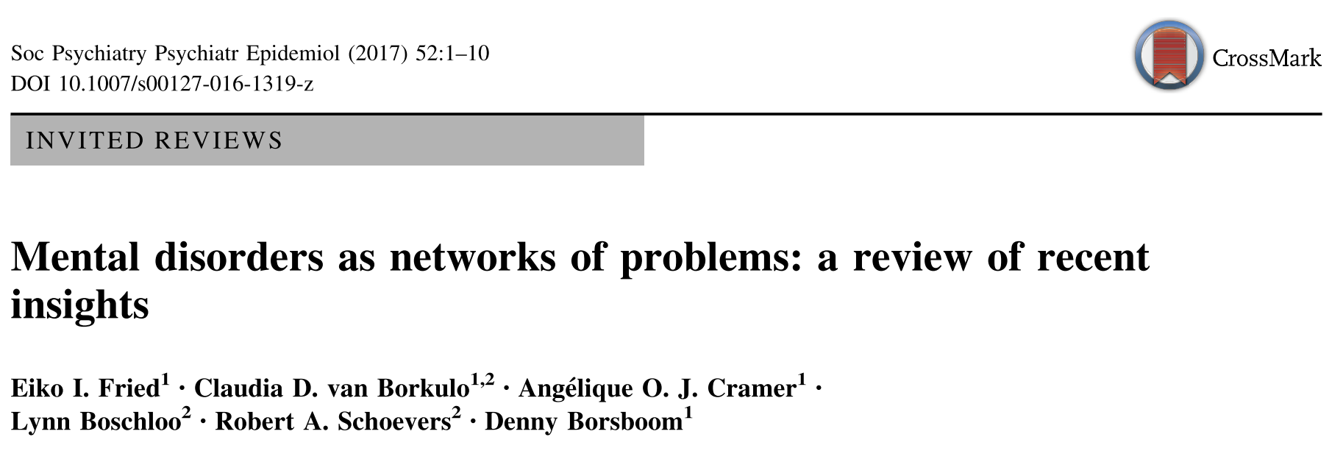
Summary paper
http://www.psychosystems.org

Slide 88
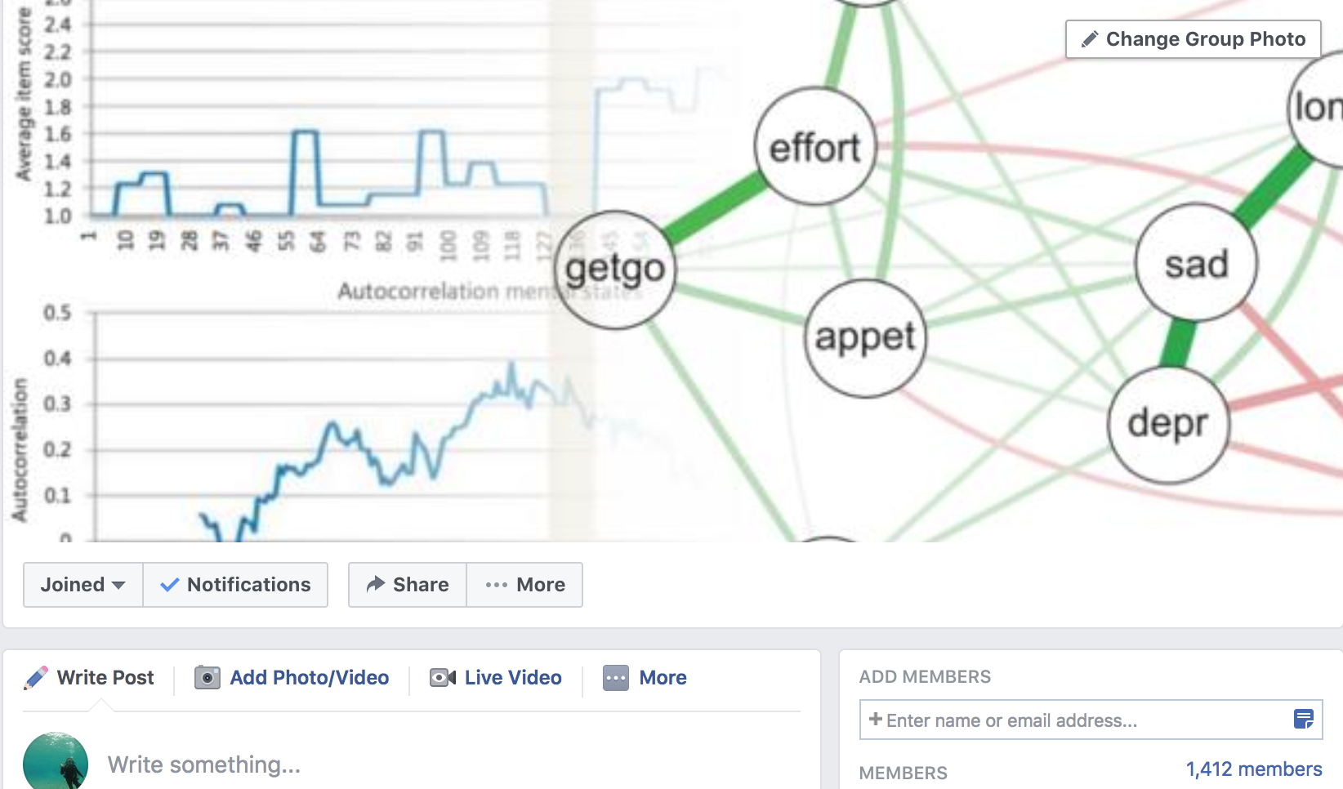
Facebook Community
facebook.com/groups/PsychologicalDynamics

Slide 89

www.psych-networks.com

Slide 90

JASP
Jasp is an open-source and free point and click interface for performing state of the art statistical analyses, developed at the University of Amsterdam. The great team of Jasp has recently implemented the first version of a network module! Feel free to try out the JASP 0.8.5 version, and let us know what you think!

Slide 91
Summary
Network theory (a.k.a. the network perspective) views psychological behavior as a complex interplay of psychological and other components
Network psychometrics has been developed in response, allowing exploratory estimation of network models from data
Network models themselves have routinely been used to study social interactions / traffic / information flow.
  Small-worldness investigates if a network is clustered, but also has a short average shortest path between all nodes
  Centrality investigates which nodes are important in a network

Slide 92
Break

Slide 93
Workshop Overview
Thursday January 11
  Morning
    Introduction & Theoretical Foundation of Network Analysis
    Drawing networks in R (part of practical)
  Afternoon
    Network Estimation and Inference (Markov Random Fields: Gaussian Graphical Model & Ising Model)
Friday January 12
  Morning
    Network Stability
  Afternoon
    Advanced Methods (Network Comparison Test, Mixed Graphical Models, Latent Variable Network Modeling)

Slide 94
Drawing networks using qgraph

Slide 95
Drawing networks
Get the latest version of R from www.r-project.org and the latest version of qgraph from CRAN:
install.packages("qgraph",dep=TRUE)

Slide 96
Drawing networks
Make sure you can load qgraph
library(“qgraph”)
And that you have version 1.4.4 or higher:
packageDescription(‘qgraph’)$Version
## [1] "1.4.5"

Slide 97
The qgraph() function
The main function in qgraph is qgraph()
  Most other functions are either wrapping functions using qgraph()or functions used in qgraph()
The qgraph()function requires only one argument (input)
A lot of other arguments can be specified, but these are all optional
Usage:
qgraph( input, ... )

Slide 98
Weights matrices
The input argument is the input. This can be a weights matrix
A weights matrix is a square n by n matrix in which each element indicates the relationship between two variables
Any relationship can be used as long as:
  A 0 indicates no relationship
  Absolute negative values are similar in strength to positive values

Slide 99
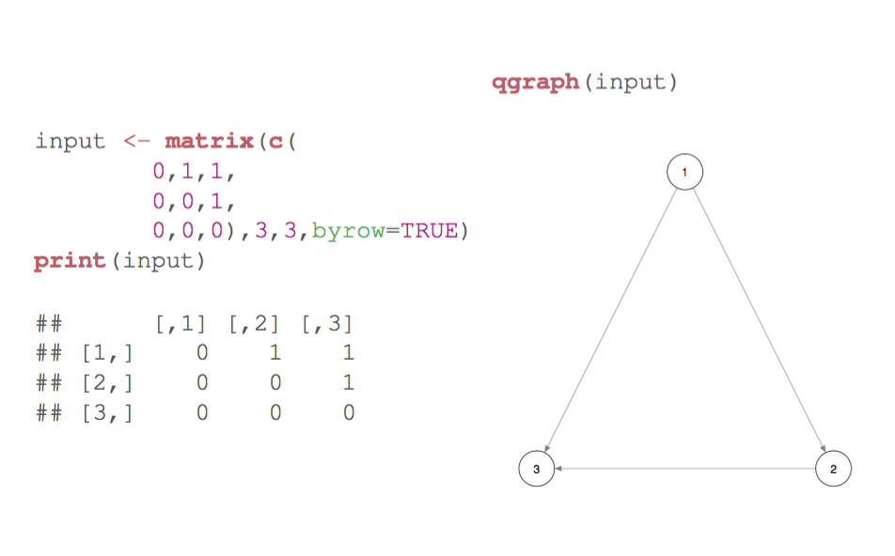
Weights matrices

Slide 100
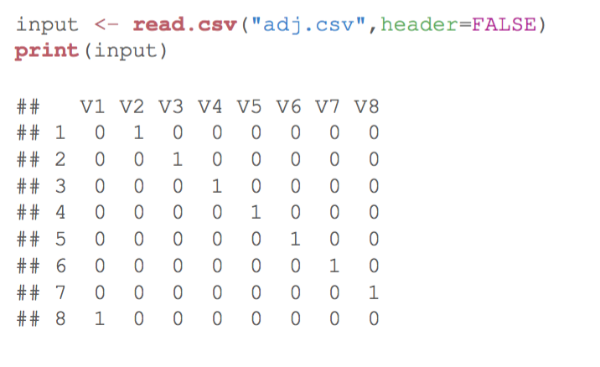
Weights matrices
Read in R (for tab delimited use read.table() )

Slide 101
Weighted graphs
Specify edge weights to make a graph weighted
  In a weights matrix: simply specify other values than only zeros and ones
An edge weight of 0 indicates no connection
Positive and negative edge weights must be comparable in strength

Slide 102
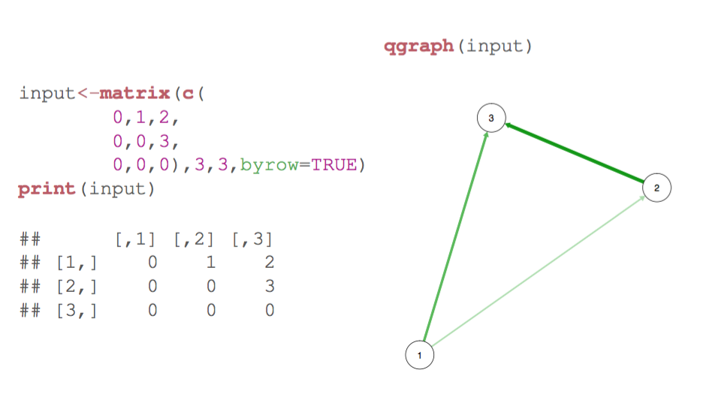
Weighted graphs

Slide 103
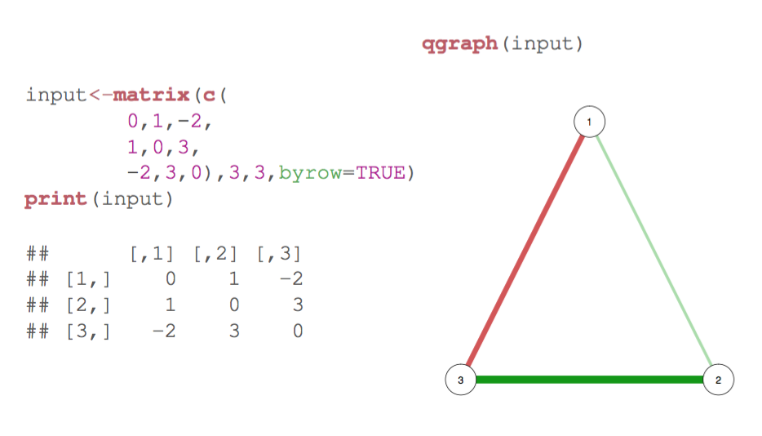
Weighted graphs

Slide 104
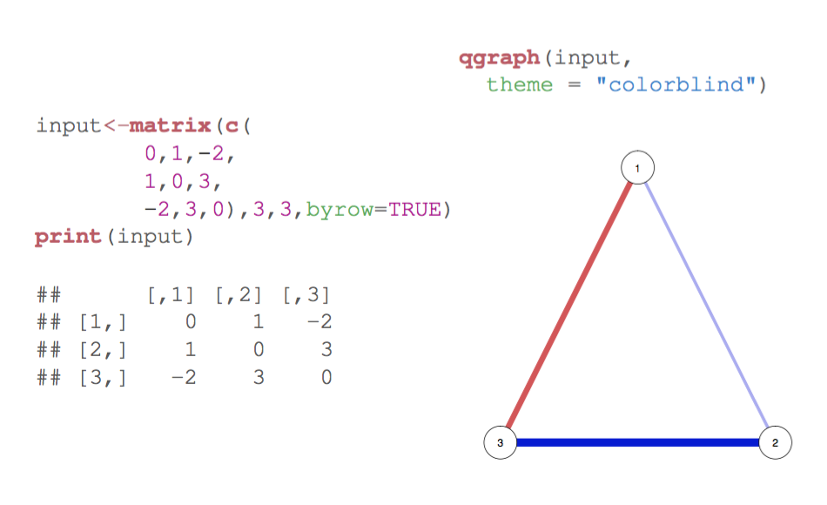
Weighted graphs

Slide 105
Weighted graphs
Under the default coloring scheme, positive edge weights (here correlations) are shown as green (colorblind theme: blue) edges and negative edge weights as red.
An edge weight of 0 is omitted. The wider and more colorful an edge the stronger the edge weight.

Slide 106
Weighted graphs
To interpret qgraph networks, three values need to be known:
  Minimum: Edges with absolute weights under this value are omitted
  Cut: If specified, splits scaling of width and color
  Maximum: If set, edge width and color scale such that an edge with this value would be the widest and most colorful
  Maximum must be set to make graphs comparable!

Slide 107
Layout modes
The placement of the nodes is specified with the layout argument in qgraph()
This can be a n by 2 matrix indicating the x and y position of each node
layout can also be given a character indicating one of the two default layouts
If layout="circular" the nodes are placed in circles per group (if the groups list is specified)
If layout="spring" the Fruchterman Reingold algorithm is used for the placement

Slide 108
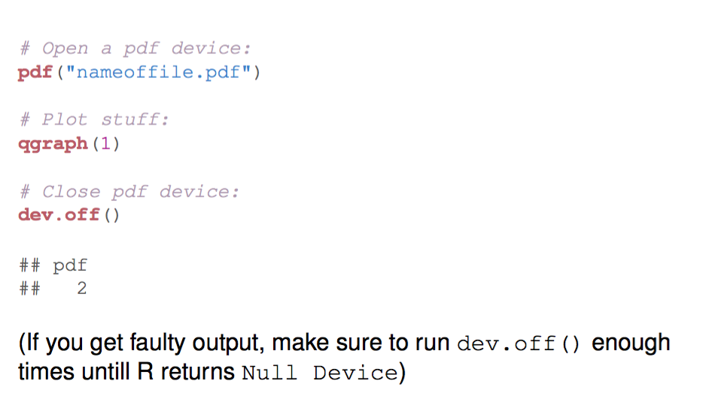
Export as PDF

Slide 109
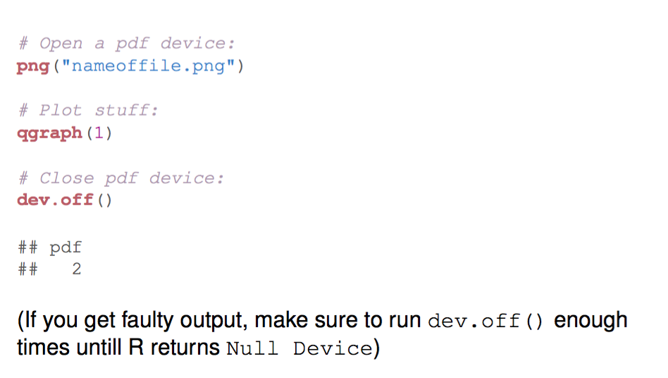
Export as PNG

Slide 110
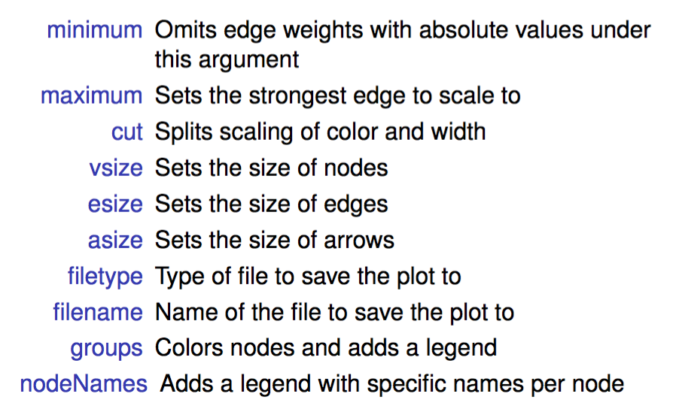
Important arguments in qgraph()

Slide 111
Practical Time!
  http://www.adelaisvoranu.com/Oldenburg2018

